Slide 2
ETUC’s priorities on VET and skills
Agnes Roman
Advisor / ETUC

Slide 3
ETUC 15th Congress - Together for a fair deal for workers
Berlin - 23-26/05/23

Slide 8
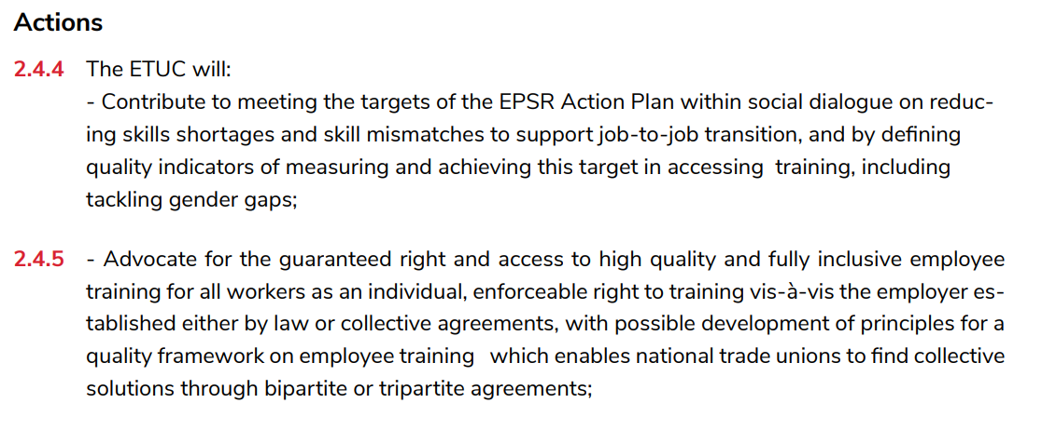

Slide 11
Recent ETUC Positions
ETUC Position on Equipping workers with necessary skills for the green transition
ETUC’s position on an EU initiative on Individual Learning Accounts
ETUC Position on enhancing validation of non-formal and informal learning
ETUC Position on Digital Education Action Plan 2021-2027
ETUC Position on the European Skills Agenda and future skills strategies
ETUC Position on renewing the European Alliance for Apprenticeship
Joint ETUC – ETUCE Position on Micro-credentials in VET and tertiary education
Joint ETUC – ETUCE Position on a European-level graduate tracking system of VET learners and tertiary education students
EU PRIORITIES ON EDUCATION AND TRAINING POST 2020 – TOWARDS A EUROPEAN RIGHT TO TRAINING FOR ALL

Slide 12
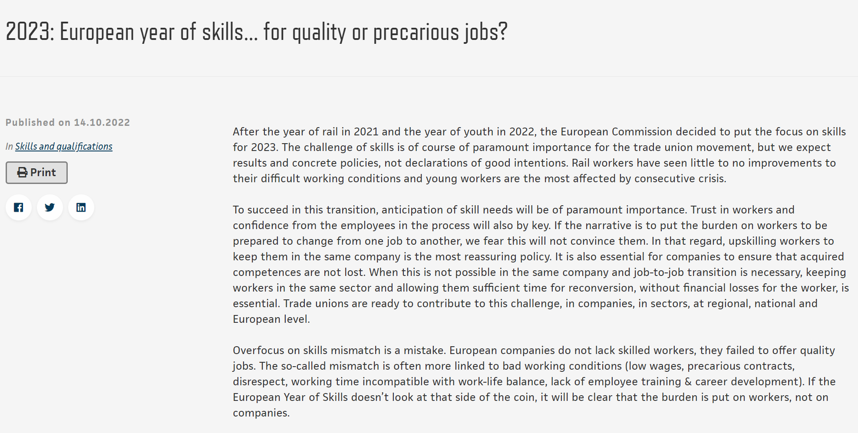

Slide 13
Commission’s objectives on EYS:
Promoting increased, more effective and inclusive investment into training and upskilling to harness the full potential of the European current and future workforce and to support people in managing job-to-job transitions, active ageing, and benefiting from the new opportunities brought by the ongoing economic transformation.
128 million adults – socio-economic responsability
Individual Learning Accounts (ILA) style systems should not leave the worker alone.
SP’s role in managing training funds, defining training conditions – collective agreements
SP’s Digitalisation Framework Agreement:

Slide 14
Commission’s objectives on EYS:
Strengthening skills relevance by closely cooperating with social partners, public and private employment services, companies, education and training providers and developing joined-up approaches with all branches of governments.
Skills strategies should link to economic, environmental, digitalisaiton startegies
Social dialogue is essential: skills forecasting, updating occupational profiles
Important of qualifications

Slide 15
Commission’s objectives on EYS:
Matching people’s aspirations and skills-set with labour market opportunities especially those offered by the green and digital transitions and the core sectors in need of recovery from the pandemic. A special focus will be given to activate more people for the labour market, in particular women and young people especially those not in education, employment or training (NEETs).
Trainings should lead to quality jobs
Workers need involvement in defining skills needs – inclusion of all types of workers
Workers need support to access trainings - guidance
Re-divert the focus from “talents”

Slide 16
Commission’s objectives on EYS:
Attracting people from third countries with the skills needed by the Union, including by strengthening learning opportunities and mobility, and by facilitating the recognition of qualifications.
No to brain drain
Access to all migrants and refugees to fair labour market
Labour shortages vs skills shortages – is this a good solution?

Slide 17
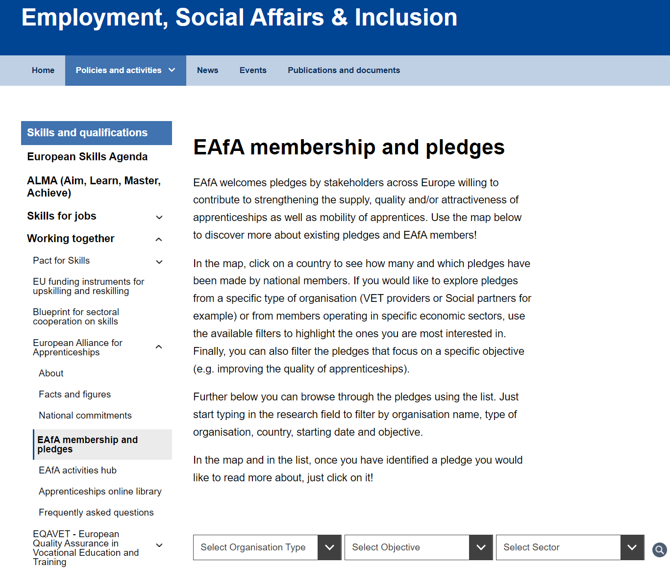
Commission’s objectives on EYS:
Apprenticeship:
10th year of European Alliance for Apprenticeship
5th year of European Quality Framework for Apprenticeship

Slide 18
About (europa.eu)
About (europa.eu)

Slide 22
Recent joint work with the employers on employee training, apprenticeship, adult learning
EU Social Partners agreement on digitalisation (2020)
Social partner recommendations on skills, innovation, provision of and access to training (2022)
Promoting Social Partnership in Employee Training - Joint Recommendations and Report (2020)
Investment in Education and Training (2017)
Towards a shared vision of apprenticeships - Joint statement of the European social partners (2016) based on ETUC’s A European Quality Framework for Apprenticeships (2016), leading to COUNCIL RECOMMENDATION of 15 March 2018 on a European Framework for Quality and Effective Apprenticeships (2018)

Slide 23
Tripartite agreements
Opinion of the Advisory Committee of Vocational Education and Training (ACVT) addressed to the European Commission on A Shared Vision for Quality and Effective Apprenticeships and Work-based Learning 2016
ACVT Opinion on THE FUTURE OF VOCATIONAL EDUCATION AND TRAINING POST 2020, 2018
ACVT Opinion on Opinion on an EU initiative on ILAs and strengthening training provision in Europe, 2021

