Slide 1
19th march 2024| EZA CONFERENCE 2024
Industrial democracy today. What it means, what it means today and how it can help democracy in itself
Francesco Seghezzi
President ADAPT
francesco.seghezzi@adapt.it
@francescoseghez

Slide 2
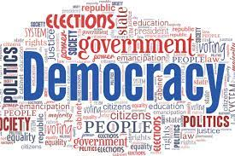
The link between the rise of populism, the crisis of democracy and the decline of industrial democracy
R. Kauffman noted the convergence of the Industrial Revolution and democratic revolution, leading to a rise in demand for industrial democracy (2004)
Industrial democracy, political democracy, and economic democracy are interconnected concepts
The principle of equality between people in a democratic system would remain an abstraction without a translation into a real economic democracy
The very possibility of the presence, acknowledgment, and legitimation of actors and institutions representing the different segments of the economy, and so of a real pluralist society, is the precondition for a democracy in a capitalist economy

Slide 3
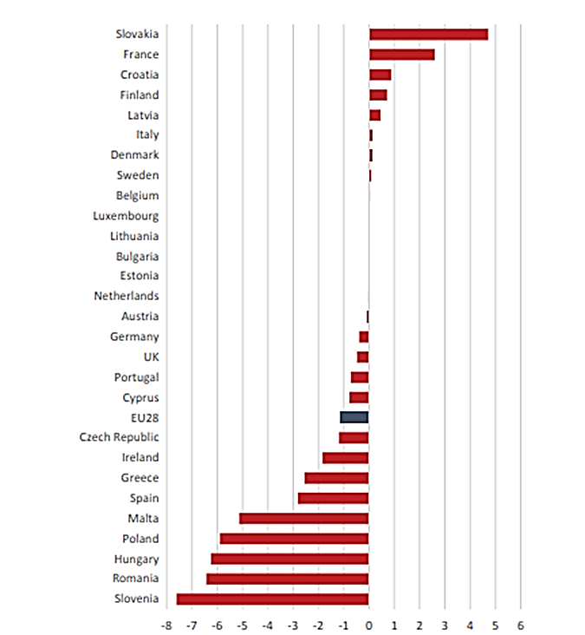
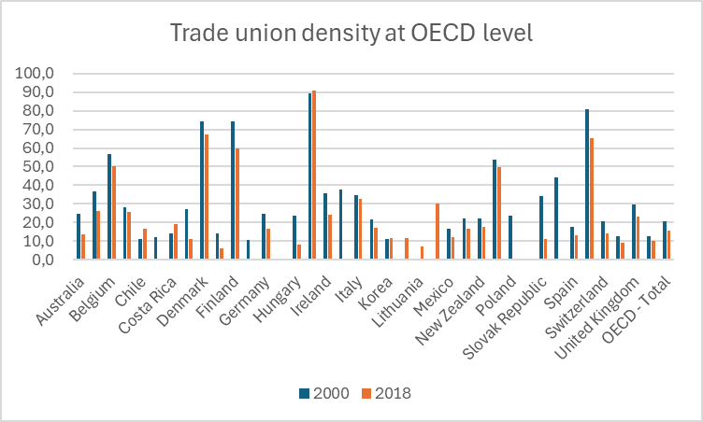
The link between the rise of populism, the crisis of democracy and the decline of industrial democracy
The crisis of Fordism also coincided, in the opinion of most critics, with the crisis of the model of industrial relations that characterized it:
OECD, Trade union density as percentage of employees
Industrial democracy index: Absolute variation of Industrial democracy scores by countries (2008–2012/2013–2017), in Sanz, P., Welz, C., Caprile, M., Contreras, R. (2020), Industrial democracy in Europe: a quantitative approach in Labour & Industry a journal of the social and economic relations of work · June 2020

Slide 4
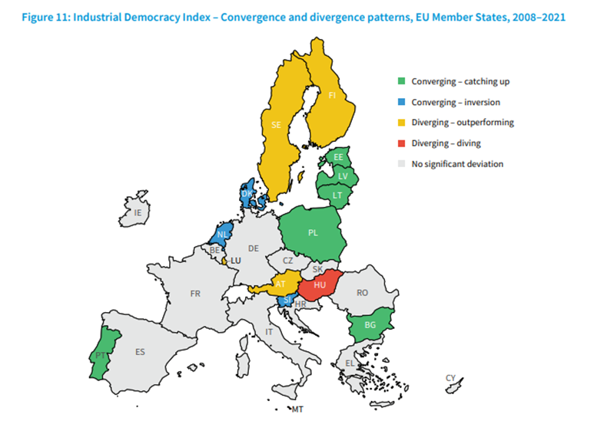
The link between the rise of populism, the crisis of democracy and the decline of industrial democracy
Industrial democracy as the set of democratic and participatory processes involving employers and employees at different levels and mainly through representative institutions (trade unions and confederal, sectoral, territorial employers' associations, bilateral bodies, workers' delegates) at all levels of economic institutions (from the single enterprise at the national sectoral level)
Industrial Democracy Index- Convergence and divergence patterns, Eu Member States, in Eurofound, Measuring key dimensions of industrial relations and industrial democracy

Slide 5
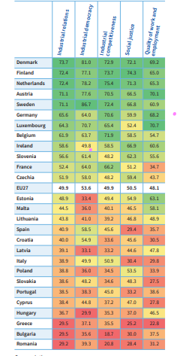
The link between the rise of populism, the crisis of democracy and the decline of industrial democracy
Numerous studies have emphasized the beneficial roles of unions and industrial democracy in relation to political democracy (Verba et al., 1995)
Populism does not inherently pose a direct threat to democracy; rather, it emerges as a manifestation of the challenges confronting democracy
Bogg and Freedland argue that "the endurance of democratic institutions in society is reliant on the endurance of democratic institutions in the domain of work and work relations" (Bogg and Freedland 2018)
Populism thus can operate as a source of identity and social cohesion, often in response to and/or as a sign of a crisis of existing sources of identity, i.e. trade unions (Mény et Surel 2000)
Industrial Relations Index scores, EU and Member States, 2018–2021, in Eurofound, Measuring key dimensions of industrial relations and industrial democracy

Slide 6
The interplay of unions, government, and political parties and its impact on the rise of populist parties across different nations
ITALY
“Populist paradise” (Zanatta 2013): early emergence of populist entities in the 90’s as a consequence of the party system crisis following the large corruption scandal (Tangentopoli broke the traditional alliances between political parties and trade unions), influx of foreign immigration and high skepticism towards Eurozone membership
Emergence of 2 additional populist entities following the 2008 crisis: Brothers of Italy on the political right spectrum and 5Star Movement on the left-wing side of the spectrum
Waning sense of legitimacy of trade unions across various segments of the workforce, because of their perceived role in facilitating labour market reforms at the margins and considered them part of the political elite
Trade unions in Italy maintained and still maintain relatively high levels of membership, and key stakeholders in labour relations continued to wield substantial institutional influence due to their integration in pivotal domains of industrial relations, the labour market, and welfare governance safeguards.
For this reason, it is possible to assert that even if all Italian populist parties went to the government (Brothers of Italy is currently in power), unilateralism and disintermediation encountered limitations.

Slide 7
The interplay of unions, government, and political parties and its impact on the rise of populist parties across different nations
SPAIN
Late emergence of populist actors compared to the other countries analyzed (Italy, France, Austria ,Poland)
Podemos, Ciudadanos and Vox emerged as a consequence of the prolonged economic downturn exacerbated by the limited political space for social demands as well as the unilateral implementation of austerity policies
Despite the participation of trade unions in numerous anti-austerity demonstrations, their involvement was not exclusive, nor predominant. Spanish grassroots actors deliberately refrained from engaging with trade unions or political parties
The protest events Spain in 2011 took the unions by surprise, as they were partially a reaction against the unions themselves (“They don’t represent us” was a central tenet of the protests)
The main unions initially maintained a distance from these protests. However, the subsequent interaction and capacity of unions and emerging grassroots actors to form coalitions created opportunities for collaboration
Institutionalization of Podemos helped someways the main trade unions to gain new institutional power resources and instill new confidence in social partners as a whole

Slide 8
The interplay of unions, government, and political parties and its impact on the rise of populist parties across different nations
FRANCE
Interesting case study because, unlike Italy, Spain, Austria and Poland, where populist parties came to power, in France populist parties have yet to govern
The economic crisis, terrorist attacks and French migration issue are elements that have impacted the development and growth of French populist parties (Rassemblement National, La France Insoumise but also populist movements such as gilet jaunes)
The Law n°2018-217 enacted by Macron heavily eroded the role of industrial democracy in the country, especially the role of trade unions in representing workers within workplaces
Despite the rate of unionisation has decreased in recent years, with the powerful protests against the pension reform wanted by Macron, trade unions regain new social and associational power resources
The unitary intersyndacal alliance opposing the pension reform clashed with the La France Insoumise , accusing it of attempting to hijack the social movement and relegate trade unions to a secondary role

Slide 9
The interplay of unions, government, and political parties and its impact on the rise of populist parties across different nations
AUSTRIA
The historical alliance between trade unions and Social Democratic and Christian Democratic parties has helped unions exert influence over years
The conservative–right-wing populist government (2000 -2006) between the conservative People’s Party (ÖVP) and the far-right Freedom Party of Austria (FPÖ’) attempted to minimize social partners’ influence and the role of industrial democracy
Despite of the decline in trade union membership and influence, particularly after the financial debacle involving ÖGB’s former bank BAWAG PSK, net trade union density reported by the OECD in 2019 is high: 27%. In addition, the collective bargaining system has continued to function effectively
Populist radical right parties have shifted towards a leftist socio-economic position in response to growing working-class support. FPÖ’s pro-welfare impact was restricted to the mitigation of welfare retrenchment for the core workforce
The power shift occurred because of the sudden end of the rightwing coalition between the FPÖ and the ÖVP in 2019 and the entry of the Green Party as coalition partner of the ÖVP
Traditionally, social and labour policy is not strong in Green parties, but the Austrian Greens also have union connections via the independent-green faction in the ÖGB (including one Green MEP) and the Chamber of Labour

Slide 10
The interplay of unions, government, and political parties and its impact on the rise of populist parties across different nations
POLAND
Trade unions and political parties very connected also due to the role of a trade union (Solidarność) in the end of the Communist regime and in the recovery of democracy
Trade unions have been meddled with politics in all the contemporary Poland history, also in the last years, this also bringing to a decline of trade unions density
The emergence of populism, as Right and Justice (PiS), is connected too with trade unions because of the presence in the party of several past union members. Its rise is related to the liberal policies of the government between 2007 and 2014 and lack of social partners involvement.
Initially, Solidarność was persuaded to support the political program of PiS, particularly due to its strong emphasis on labor issues. However, this support inadvertently resulted in a weakening of the union, primarily because the government took on labor-related matters without adequately involving social partners
This lack of engagement became evident during the emergence of the pandemic, wherein strategic decisions were made without consulting them

Slide 11
Trade union actions aimed at promoting and strengthening democratic and participatory processes
ITALY
The most important initiative appears to be the popular legislative initiative of CISL on participation and economic democracy which gathered 400.000 signatures and it is intended to promote all the forms of workers participation (financial, managerial, organisational and consultative participation) in the workplace.
All trade unions emphasize the necessity of strengthening social dialogue at the institutional level and at the company level in order to promote, spread and consolidate workers’ participation in small and medium-sized workplaces, which usually lack strong workers’ representation, as opposed to big companies.
CGIL is launching three different referendum in order to cancel labour laws considered against workers right, in this directly entering in the political arena.

Slide 12
Trade union actions aimed at promoting and strengthening democratic and participatory processes.
SPAIN
Mobilization of complementary power resources such as social movement unionism and alliances with civil society movements
CGT and CC.OO also elaborated a manifesto to contrast the far-right populist party Vox
Consolidation of institutional social dialogue as the intermediary avenue between political democracy and industrial democracy and openness towards governmental proposals
Use of social media to facilitate communication in simpler language so as to address day-to-day issues of workers (USO)
Advocacy actions for the establishment of standardized procedures for worker participation across all workplaces, without penalizing smaller ones.

Slide 13
Trade union actions aimed at promoting and strengthening democratic and participatory processes.
FRANCE
Returning to large-scale mass mobilizations orchestrated by the alliance of all the major trade unions to oppose pension reforms, marked by historical levels of participation.
CGT created a booklet to propose alternative projects to redirect and diversify activities in order to save threatened jobs while responding to the needs of populations and workers, territorial civil society organizations as well as the planet. An exemplary "CGT Project" is the transformation of the Cordemais carbon power plant. After seven years of mobilization involving trade unions, workers, and civil society organizations, due to the plant facing closure in response to climate policies, they successfully orchestrated its conversion. Now, the plant's focus will shift towards the transformation of wood into electricity.
In 2022, CFTC's Executive Director Cyril Chabanier reiterated the call to oppose far-right ideologies, echoing a stance from 2017. Yet, in 2016, the CFTC encountered unity challenges due to its Vice President's participation in a demonstration alongside far-right figures. Emphasizing its stance, the CFTC underscored its disagreement with far-right ideologies, particularly concerning intolerance towards specific groups.

Slide 14
Trade union actions aimed at promoting and strengthening democratic and participatory processes.
AUSTRIA
Austrian trade unions have historically not focused on extending societal power, but recent political situations and the general shift of power from labor to capital have prompted a reevaluation. Unions have become more involved in civil society demonstrations and campaigns, recognizing the importance of coalition-building with other social movements.
The ÖGB (The Austrian Trade Union Federation which comprises all trade unions organized under one umbrella organization) has supported major protests and has been active in social movements. particularly regarding social-ecological transition.
In addition, ÖGB underlined how it actively participates to the ITUC For Democracy campaign, aiming to unify the power of working people towards a trade union vision for democracy.

Slide 15
Trade union actions aimed at promoting and strengthening democratic and participatory processes.
POLAND
During pandemic, the absence of involvement in strategical decisions of social partners generated protest by all unions, included Solidarnosc with a public statement named “Protest of employers’ organisations and trade unions regarding the assault on the independence of the Social Dialogue Council and the autonomy of social partners” followed by a letter of support signed by European social partners.
Several new companies (included Google) unionized in the last years.

