Slide 1
Brace for impact: seat projection for the upcoming #EP2024 election results
What polling data tells us about the political trends for the 2024 European Parliament election
Cornelius Hirsch @ EZA Brussels Conference – March 20, 2024

Slide 2
First things first – I don't own a functioning Chrystal ball
Polls ask, “Who would you vote for if the election were held today?”
Voting intention polls in the last weeks before an election tend to miss the actual results of a party on average by just 2 percentage points.
In the European Parliament election, realignments and new parties joining European Parliament groups have a significant impact on final results

Slide 3
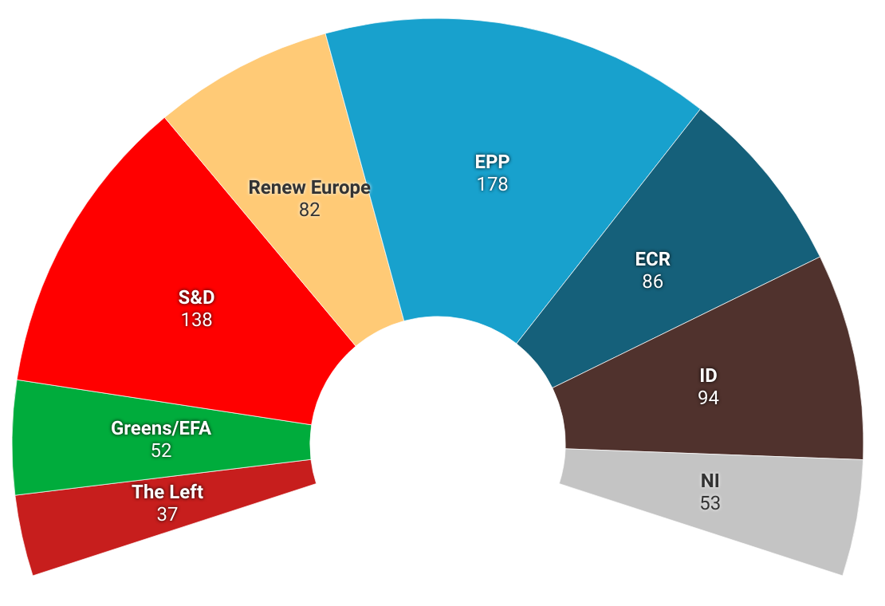
Here's what the political hemicycle could look like if the 2024 European Parliament election were held today.
Based on polls asking about the voting intention in the European Parliament election in each country.
Combined with polls asking about the voting intention in the national parliament elections.
New and unaffiliated parties allocated to the politically closest European Parliament group.

Slide 4
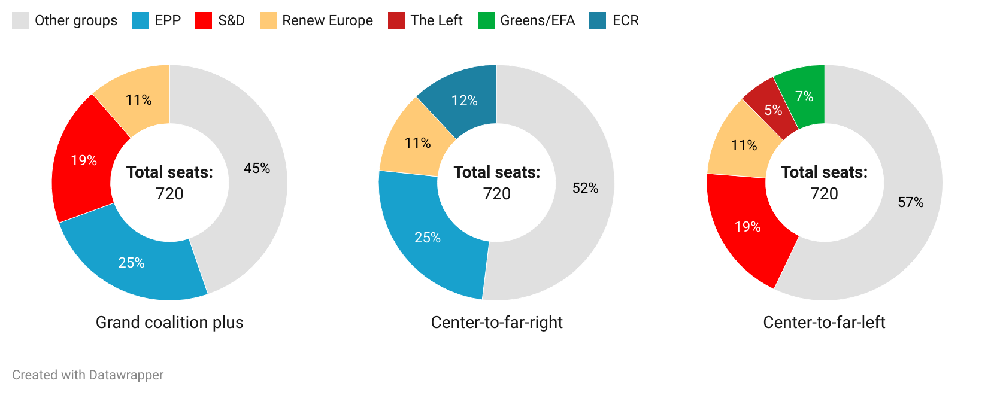
The "grand coalition plus" can count on its majority

Slide 5
More details and data analysis on corneliushirsch.com
Thank you for your attention.

