Slide 1
EZA Brussels Conference 2024
European elections 2024 and beyond:
European democracy and the EU’s social dimension at stake
“The Historical and Current Rise of Populist Parties in the EU”
Professor Daphne Halikiopoulou
Chair in Comparative Politics
University of York

Slide 2
Outline
The state of the far right:
  The rise of far-right populism in Europe
  Projections for the forthcoming EP elections
The parties
  Multi-faceted nationalist appeals
  Regional patterns
The voters
  Who votes for far-right populists?
  Profiling voters with different concerns
Why this is a threat to democracy
  Implications
  How should we respond?

Slide 3
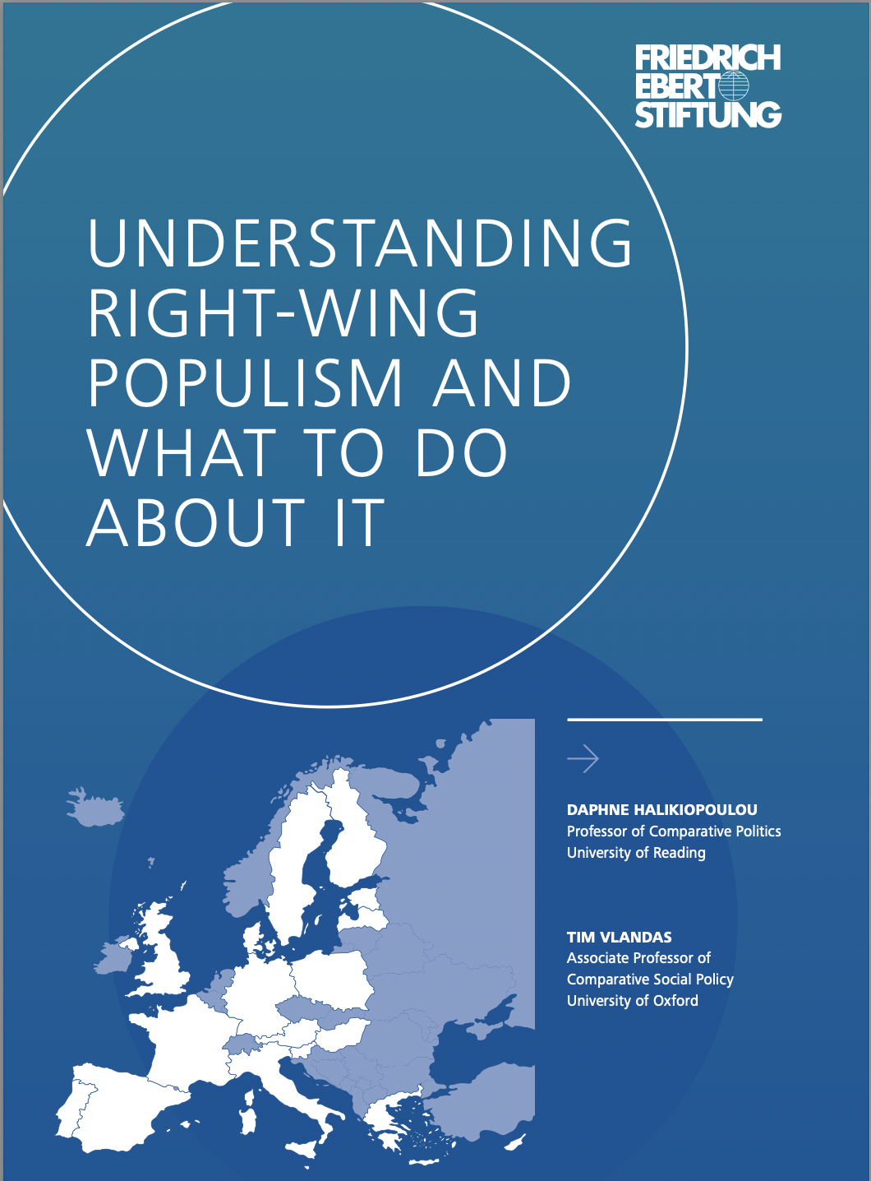
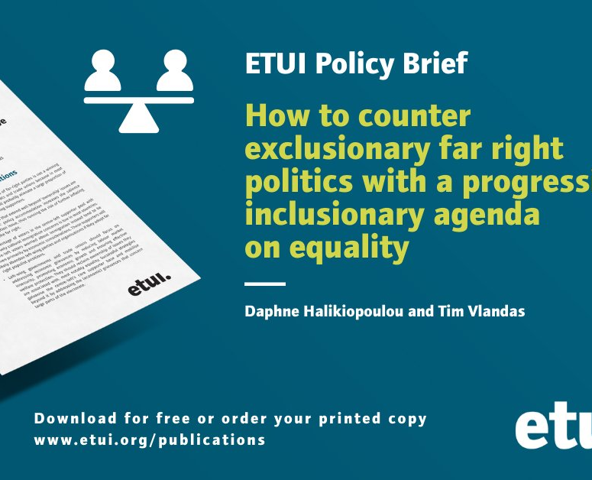

Slide 4
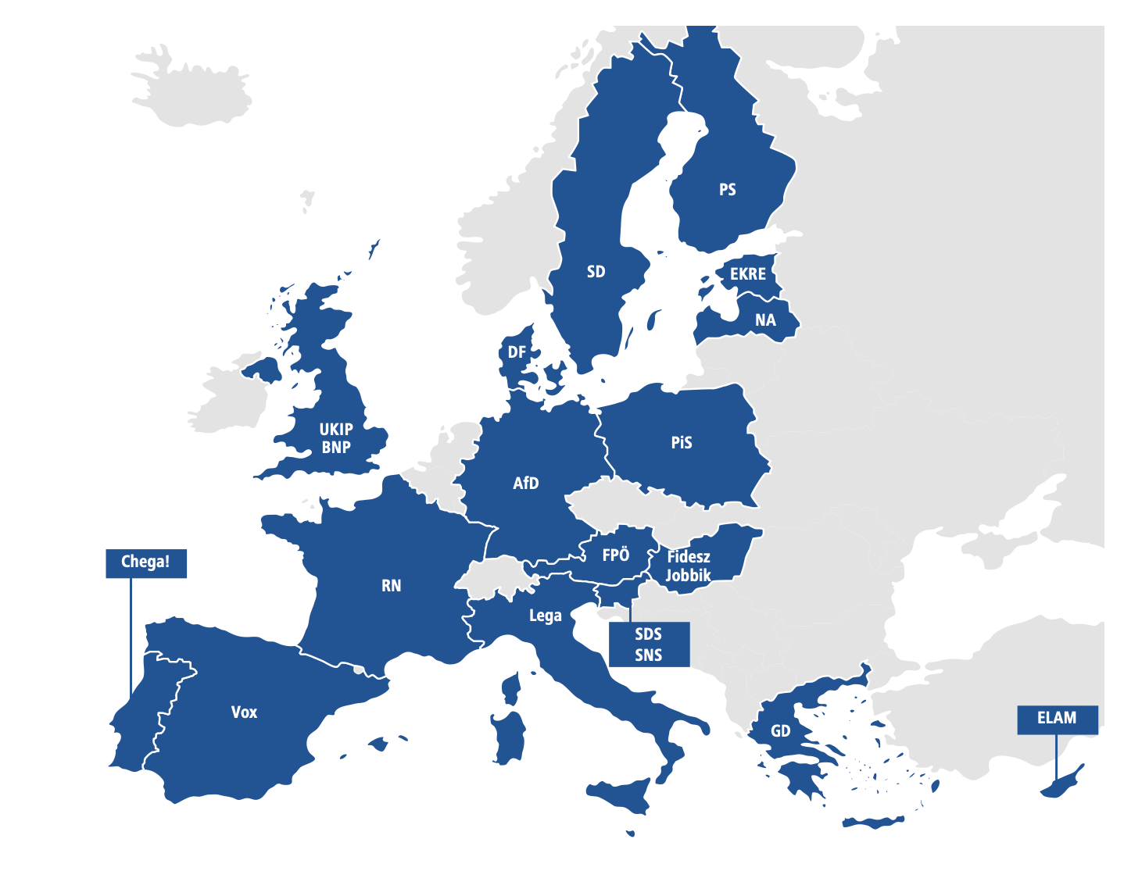
The state of the far right
Populist: society is separated into two homogeneous and antagonistic groups, “the pure people” versus “the corrupt elite”
Far right: nativist/states should be inhabited exclusively by members of the native group
Nationalist solutions to all socio-economic problems
Notes:
Contrast with populist left/ far-left

Slide 5
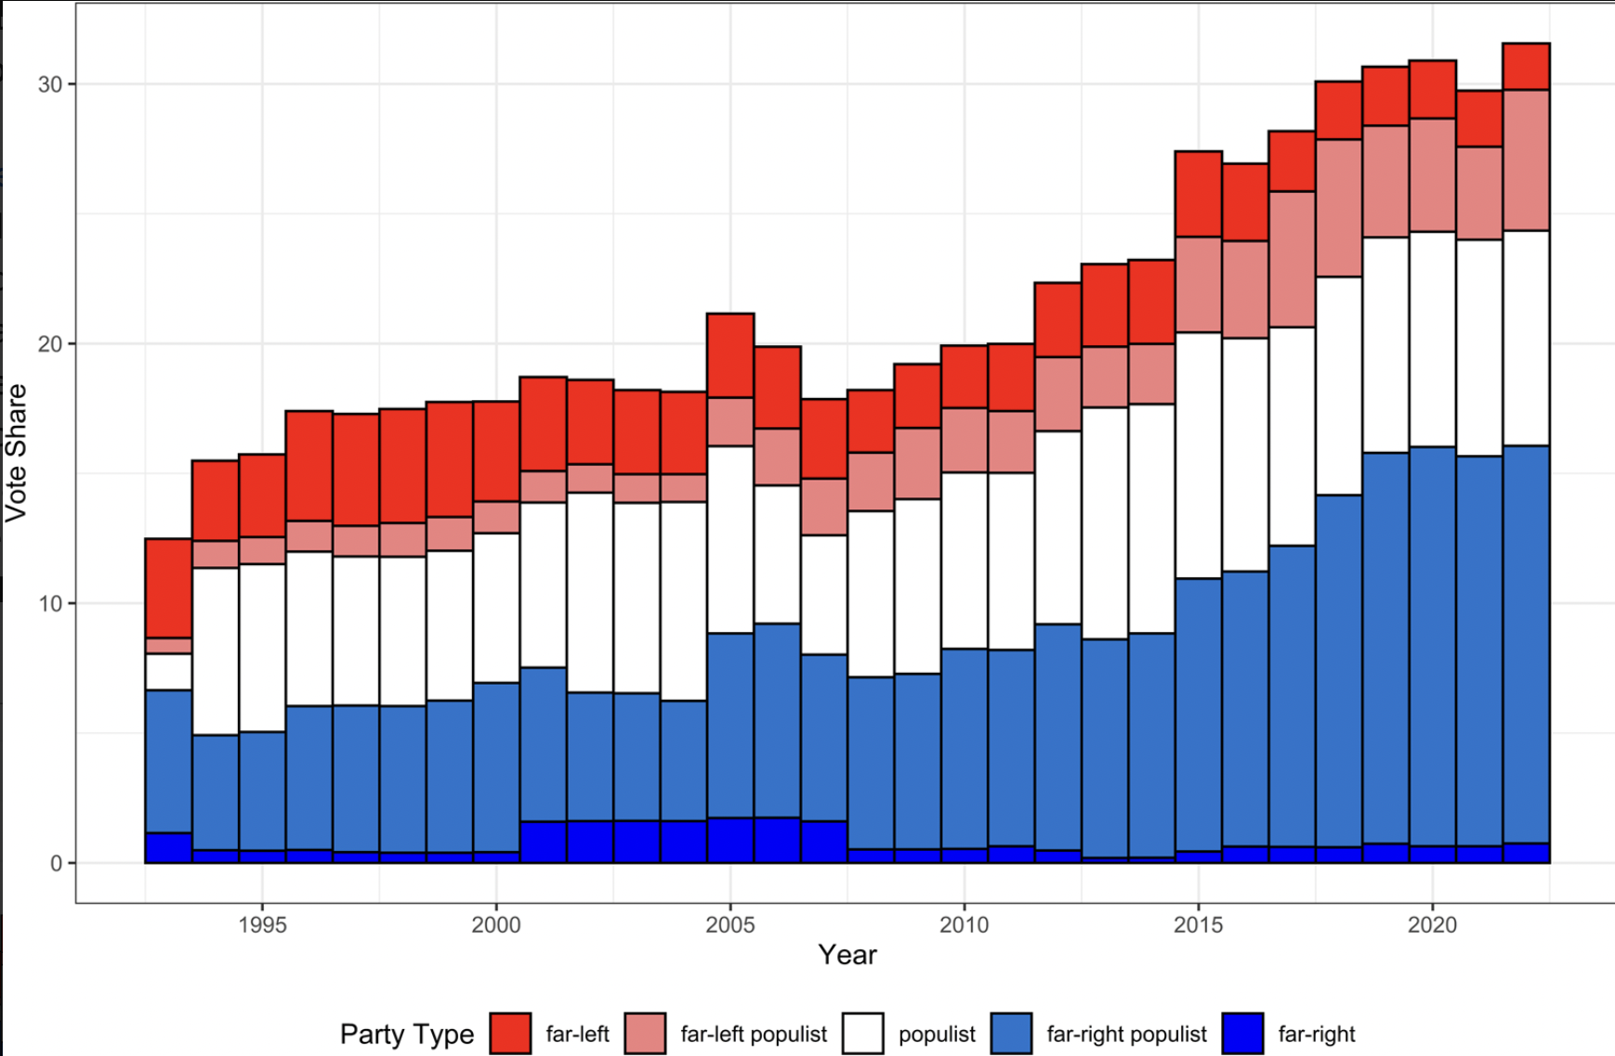
The state of the far-right: http://www.popu-list.org
Source: the PopuList
Notes:
Rise of democratic challengers
Variation and some poor perfomances recently: see AfD, FPO, GD
However, the big picture is one of increase

Slide 6
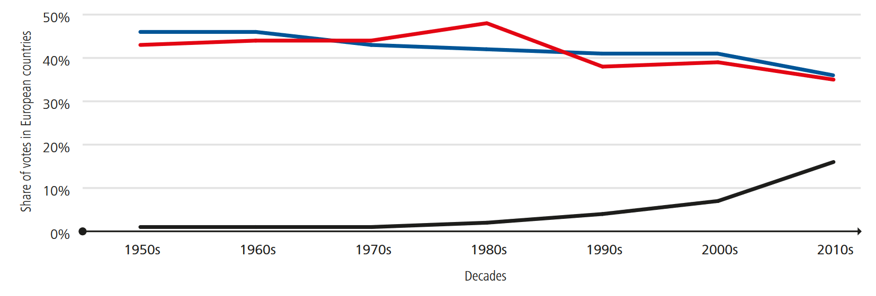
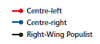
The state of the far-right: threefold success
Notes:
Three-fold success:
Electoral performance
Entry in government
Normalisation and party competition

Slide 7
1. The state of the far-right: threefold success
Electoral performance: e.g. RN, AfD, Vox, Chega
Entry in government: e.g. Lega, FdI, PiS, Fidesz, EKRE, PS
Normalisation and party competition: breakdown of cordon sanitaire, e.g. SD, DF, RN

Slide 8
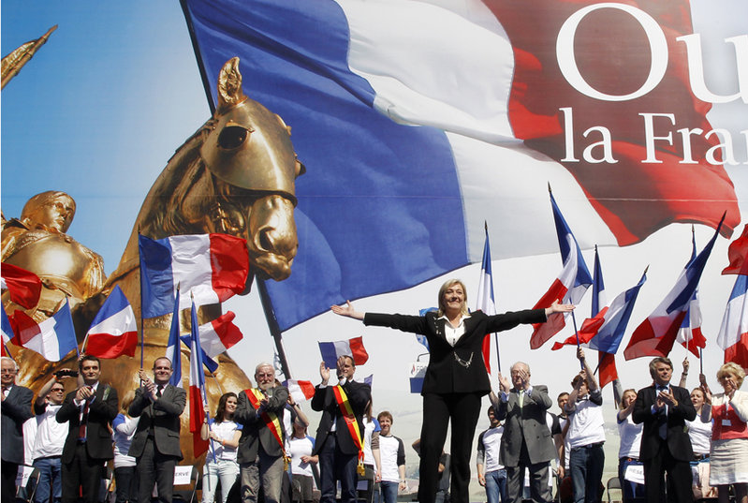
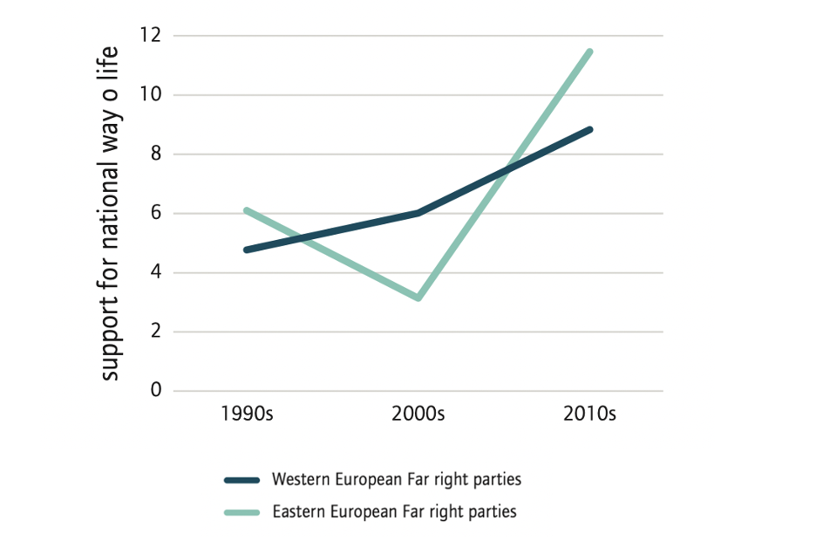
2. The parties: multi-faceted nationalist appeals

Slide 9
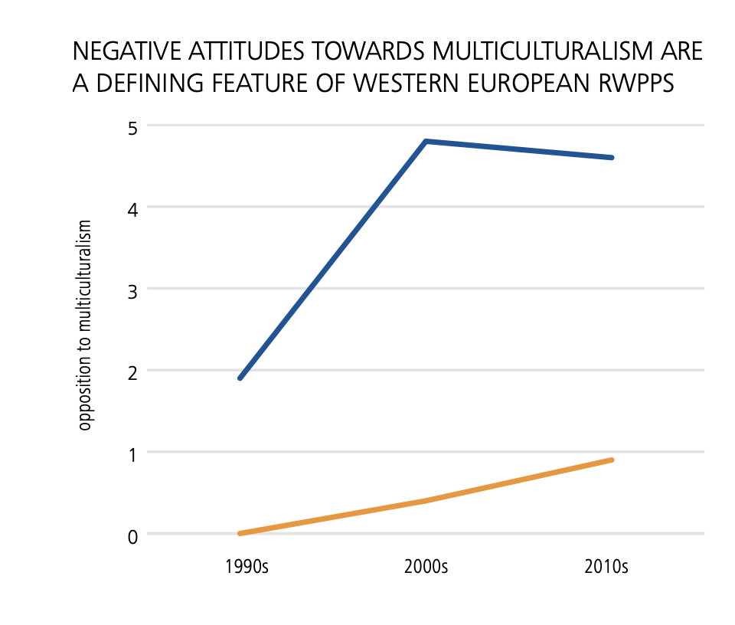
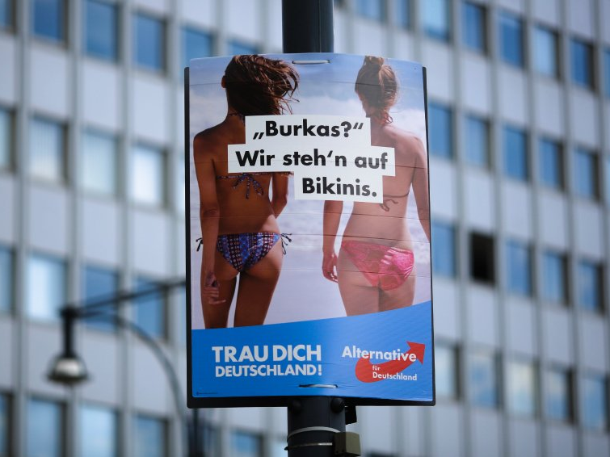

2. The parties: regional patterns

Slide 10
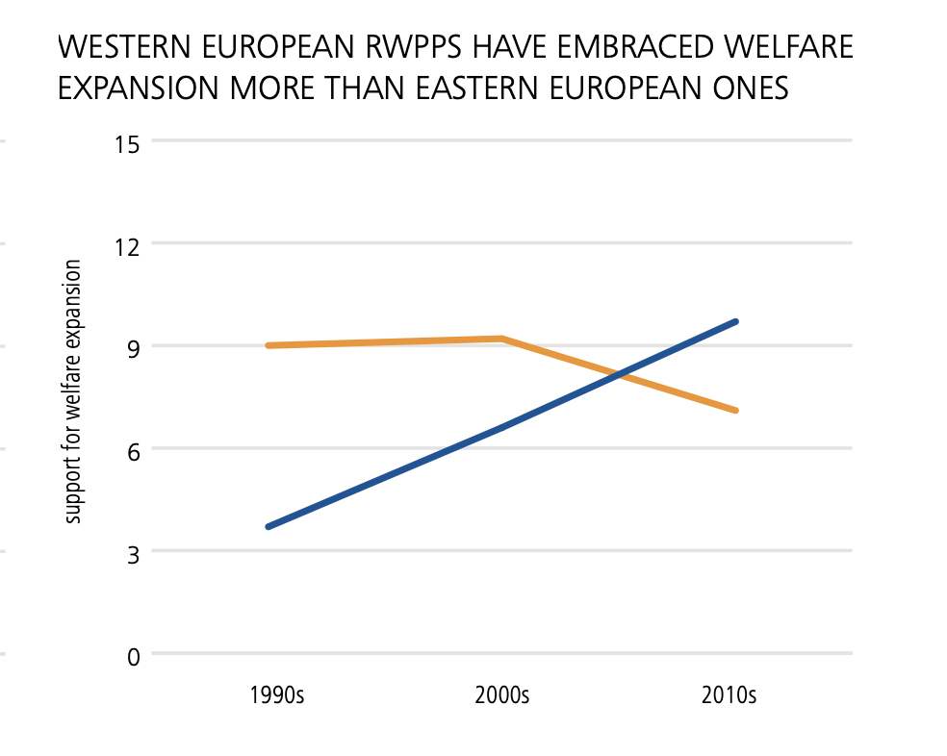

2. The parties: regional patterns

Slide 12
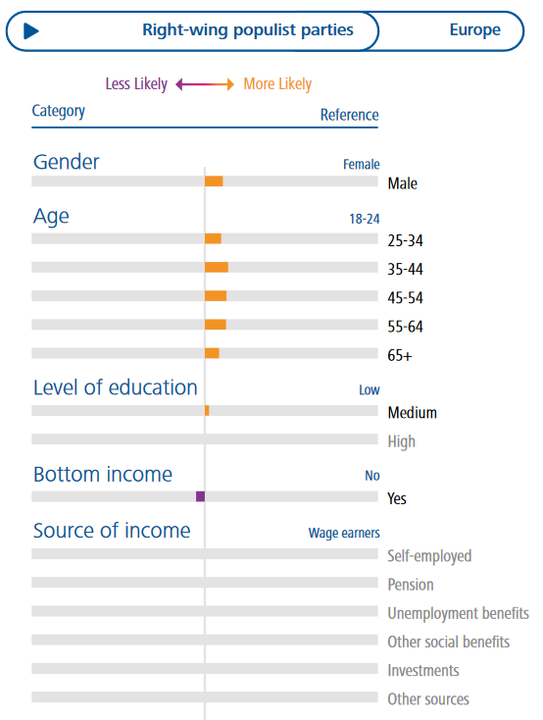
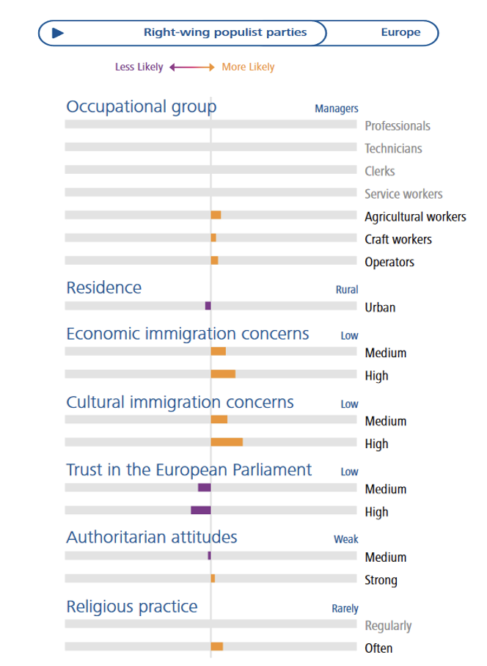
3. The voters: who votes for far-right populists?

Slide 13
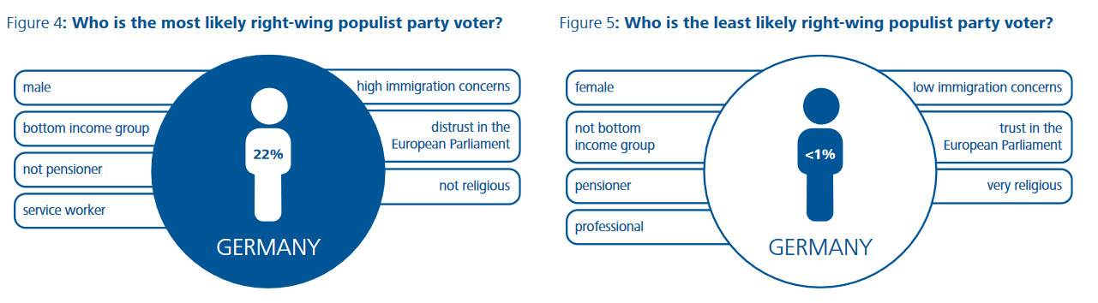
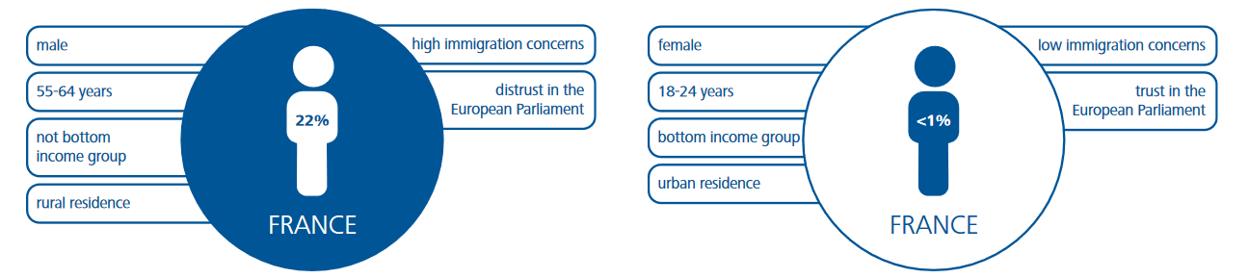
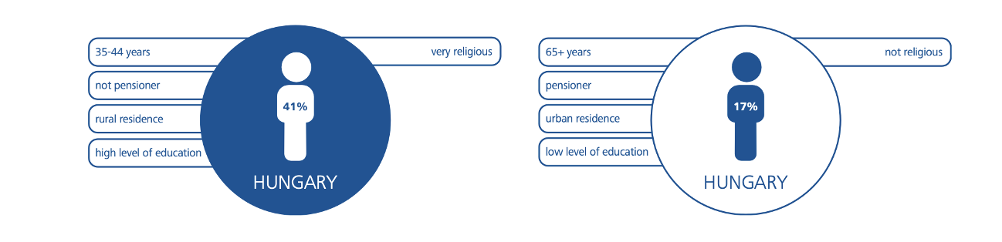
Notes:
Lets look at predicted probabilities
DE: males in bottom income group, service workers who distrust EP and have immigration concerns
FR: older males not in bottom income group in country side, anti-immigration and Eurosceptic
SWE: unemployed males, operator occupations, not high educ, distrust EP and anti-immigration

Slide 14
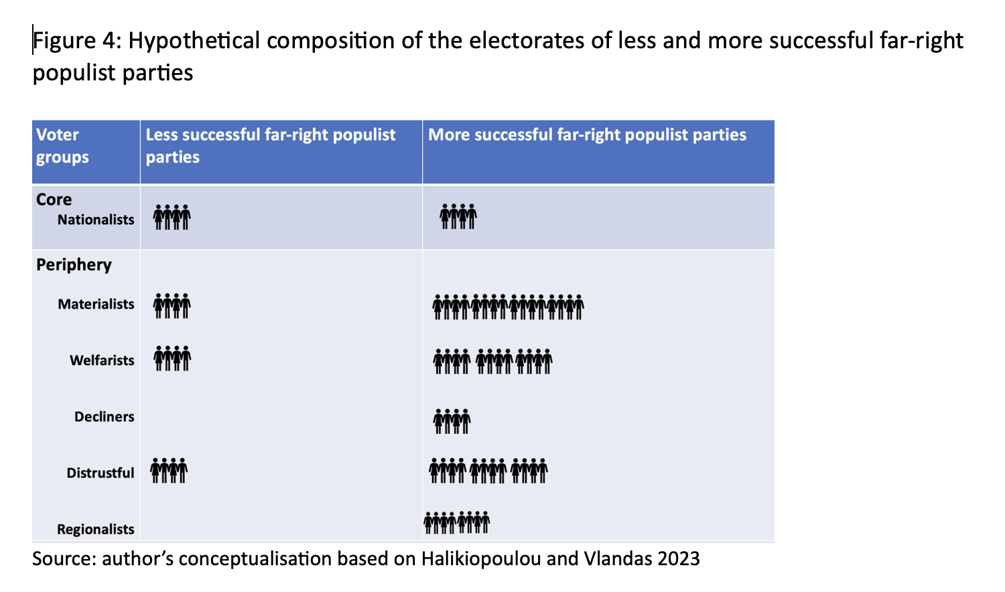
The voters: profiling voters with different concerns
Core: driven by ideology (nationalism)
  ‘culturalists’
  Ideologically anti-immigrant individuals
  Identify fully with FR party platform
  Small share of the FR electorate
Peripheral: driven by protest / discontent
  ‘materialists’
  ‘welfarists’
  ‘Decliners’ and ‘stagnants’
  Those who distrust institutions
  The ‘regionalists’
  Together much larger share of the FR electorate
Notes:
Far right party success: coalition of voters with different concerns

Slide 15
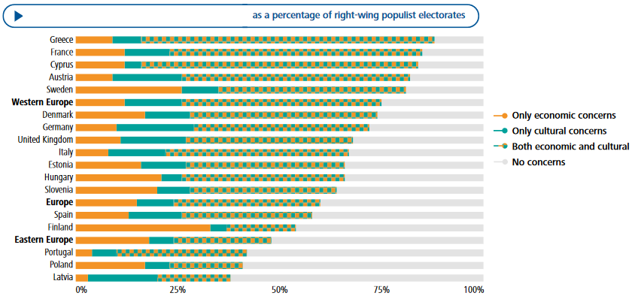
‘Culturalists’ and ‘materialists’

Slide 16
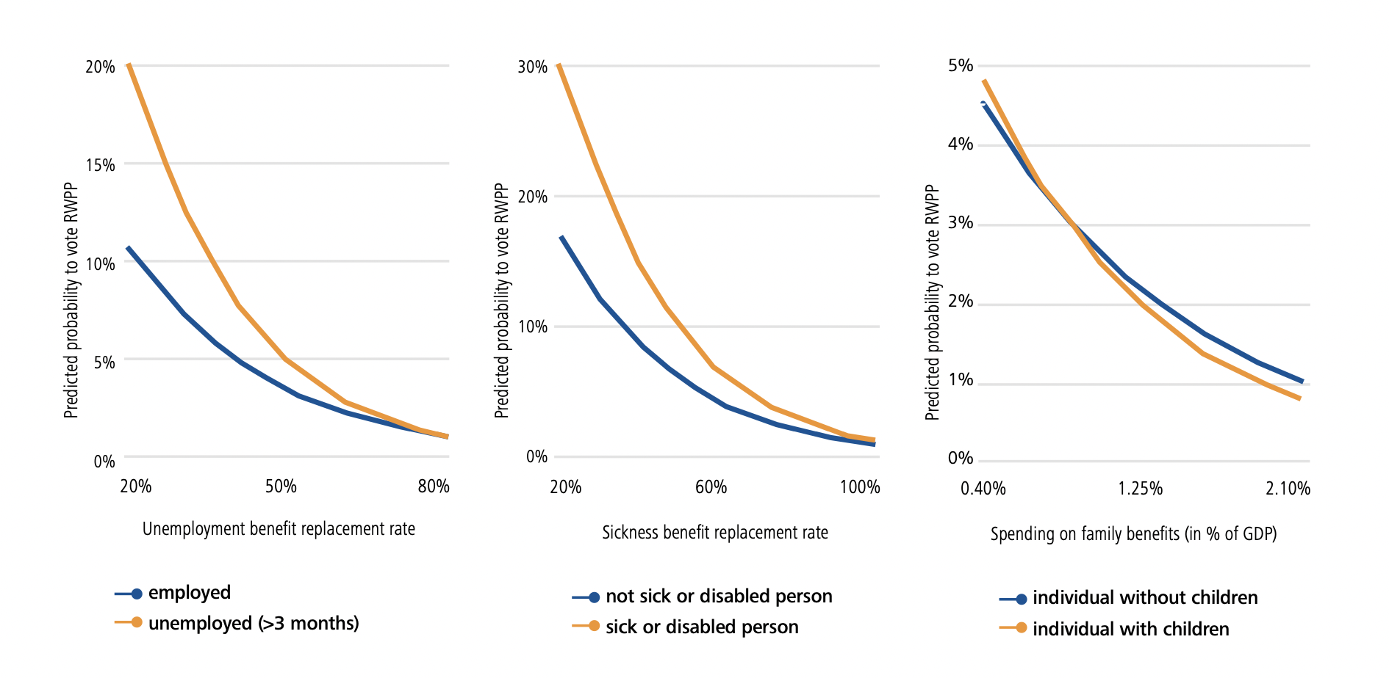
Welfarists
‘Welfarists’
Notes:
We’ve run some analyses across Europe to calculate probabilities voting for far right for different groups facing more or less insecurity depending on generosity of policy environment

Slide 17
‘Decliners’ and ‘stagnants’ (and the upwardly mobile?)

Slide 18
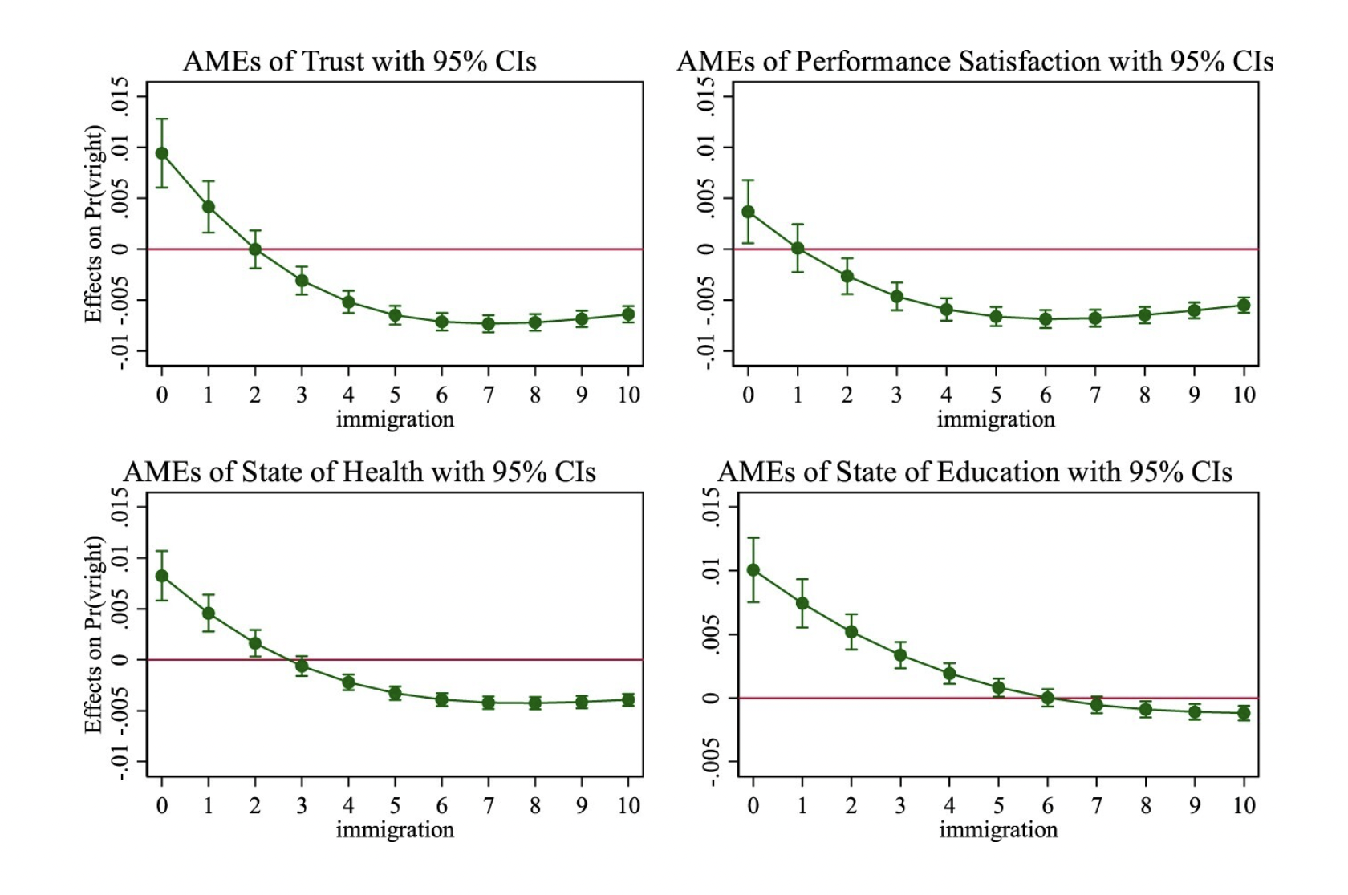
Those who distrust institutions
Notes:
Peripheral voters: Individuals who trust their domestic institutions and positively evaluate system performance and policy outputs are less likely to opt for a far right part
Core voters: as evaluations of the democratic process improve, their likelihood to opt for the far right increases, revealing a potentially galvanising effect among some anti-immigrant voters.

Slide 19
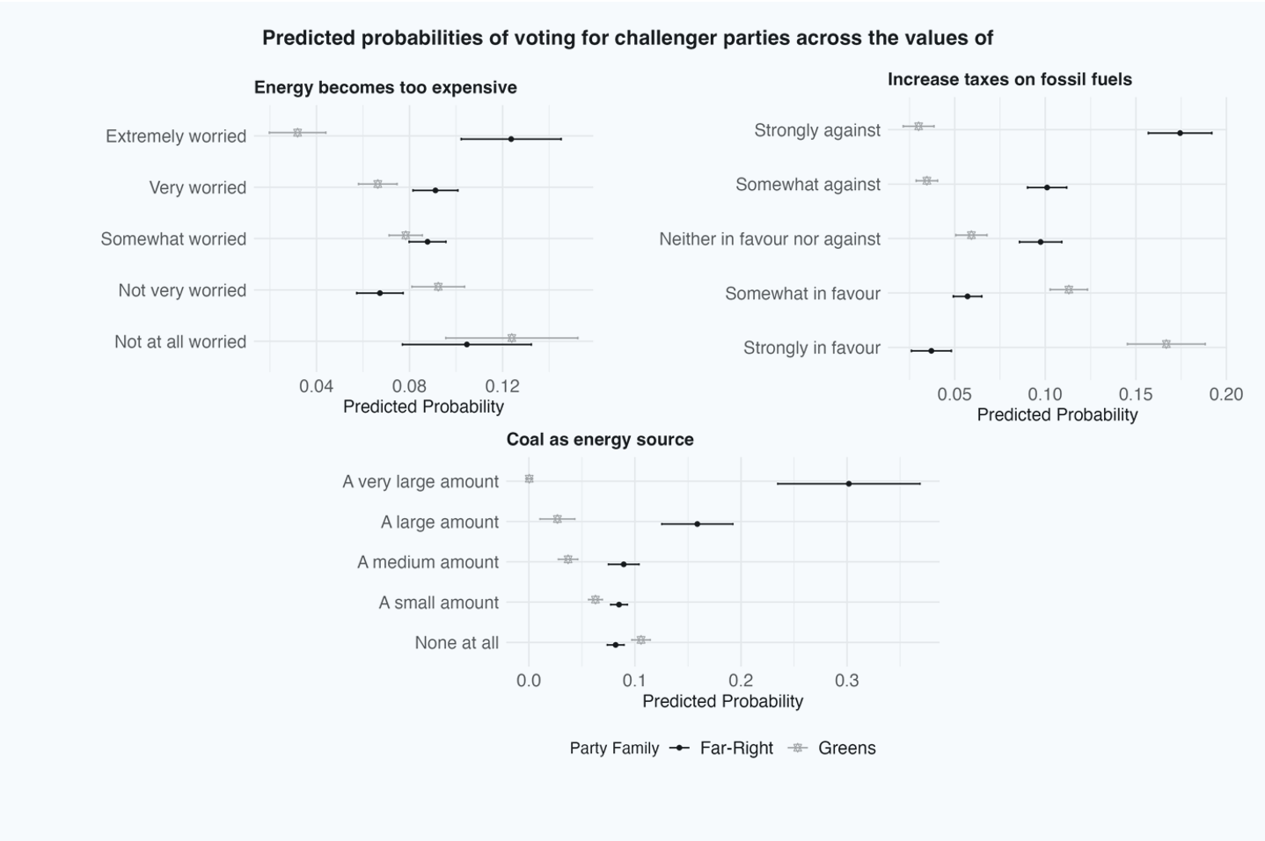
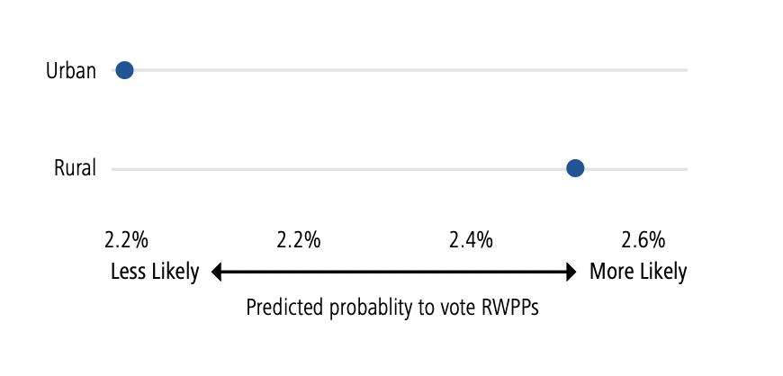
The ‘regionalists’
Notes:
FR party pronounced in rural areas
Why? regional resentment
-feel competition with immigrants
-resent mainstream because their regions are forgotten
-pay concentrated costs for climate policies
Return of centre-periphery divide in Europe

Slide 21
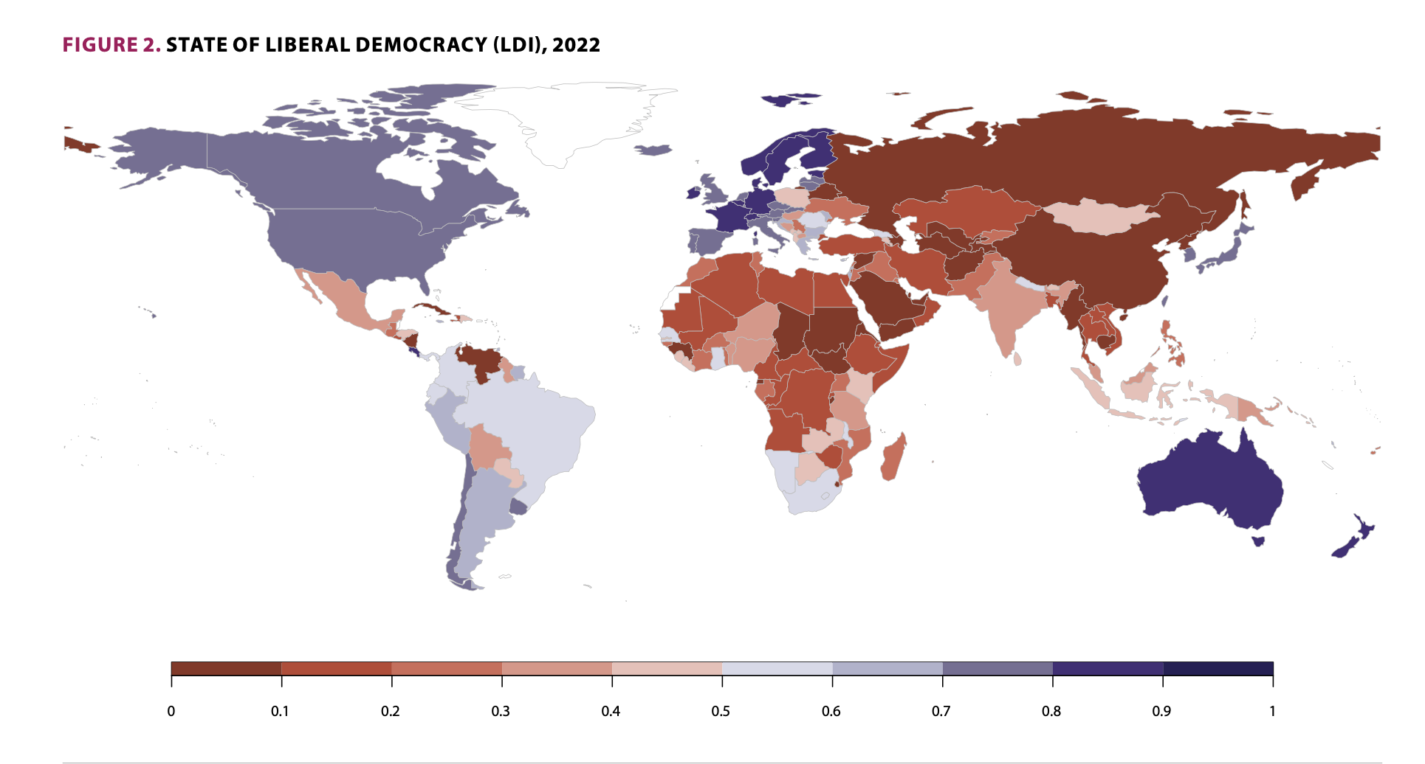
4. Why this is a threat to democracy: implications
Systemic entrenchment leads to the normalisation of hate and extreme ideas
Far-right populism is emboldened by, and in turn exacerbates, political polarisation
Far-right populists in power compromise liberal democratic institutions.
Far-right populism reinforces a vicious circle of economic and democratic decline
V-Dem: the level of democracy in 2022 is back to 1986

Slide 22
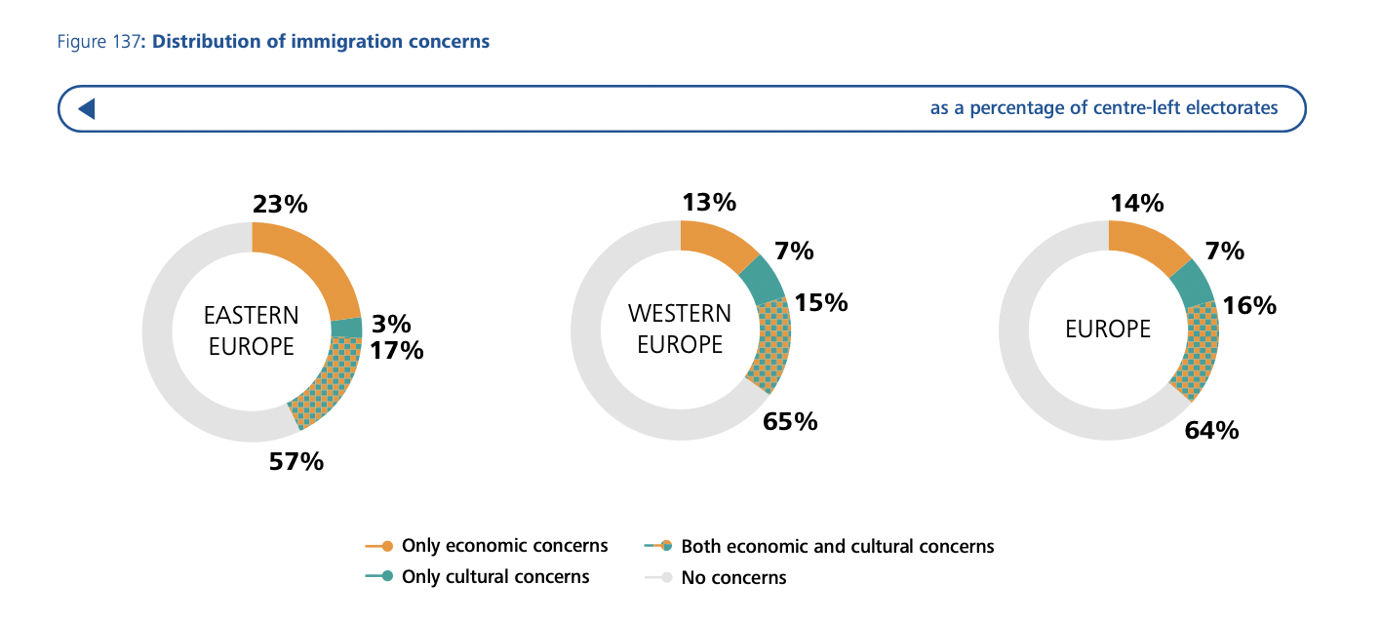
Why this is a threat to democracy: how should we respond?
Don’t do it like the far right!
Co-opting far right anti-immigrant/ populist narratives is not a winning strategy: don’t make elections about immigration
Strategy for democratic empowerment:
  What other parties say and do matters
  Policies matter
  Consensus matters
  Engagement matters
Notes:
Do not get drawn into debates on emergency/threat posed by immigration, where we have to ‘defend’ it. This puts us in losing position
Frame the debate on economic prosperity and addressing key societal challenges to which immigration is a solution:
-demographic decline
-labour shortages

Slide 23
Thank you!
Questions?

