Slide 1
European Elections
Delivering a
Fair deal
for Workers
Tom Shannon, ETUC Advisor

Slide 3
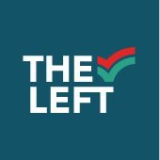
Latest European Election Polls
24 Seats Total
14 Seats
41 Seats (ECR: 20, ID: 21)
Source: EU Elects

Slide 4
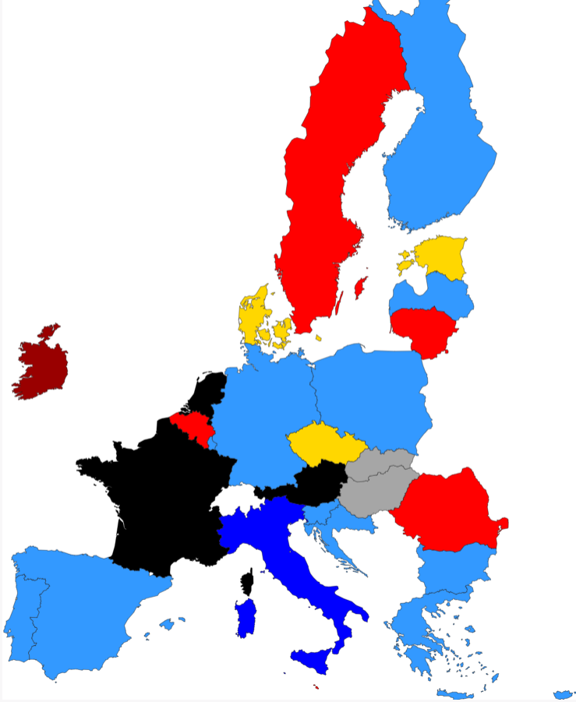
Groups in the lead
Source: EU Elects

Slide 5
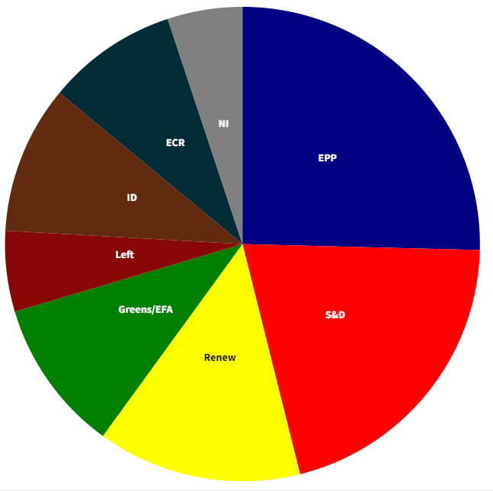
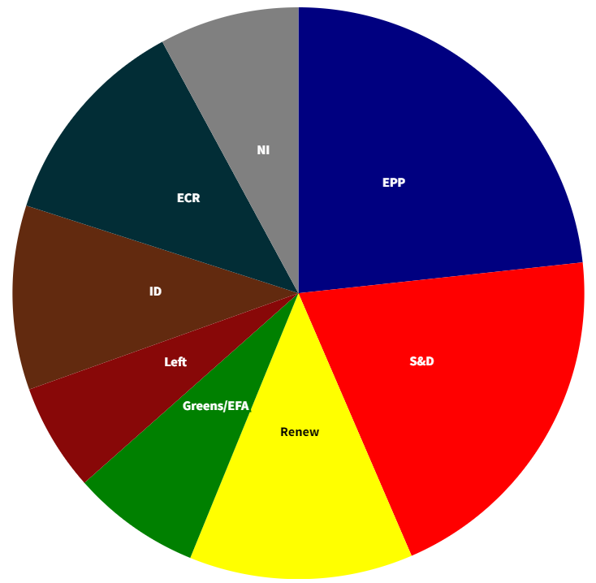
European Parliament Breakdown
Previous Election %
Seat Projection 2024
Source: EU Elects

Slide 6
German Trends (3 years)
Source: Politico

Slide 7
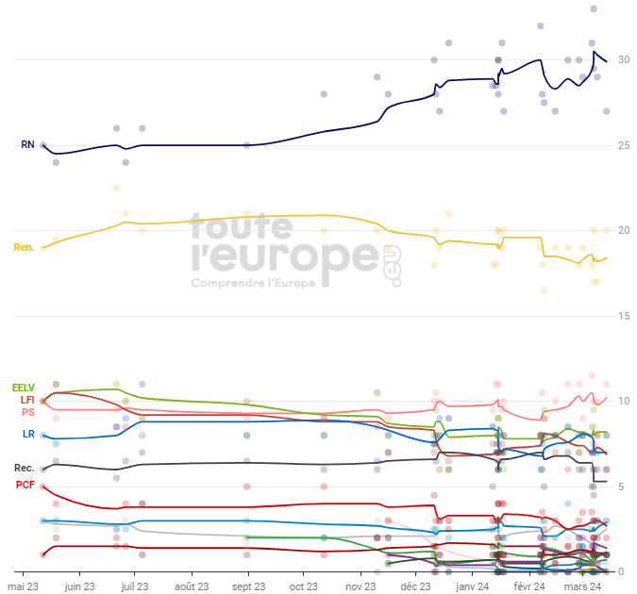
French EU Elections
Source: touteleurope.eu

Slide 8
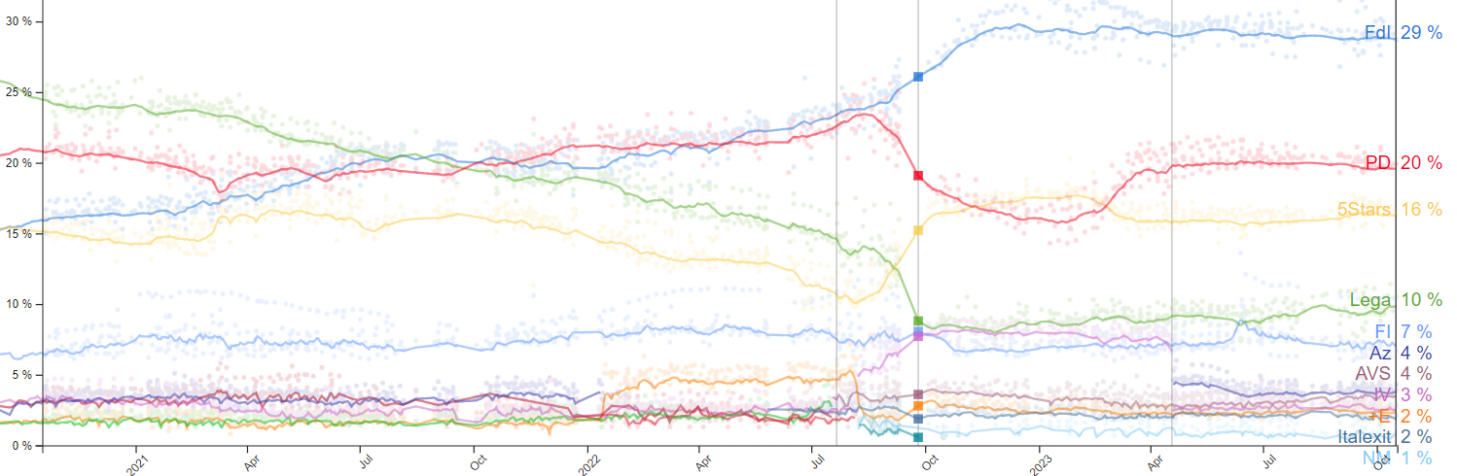
Italian Trends (3 years)
Source: Politico

Slide 9
Austrian Polls (3 years)
Source: Politico

Slide 10
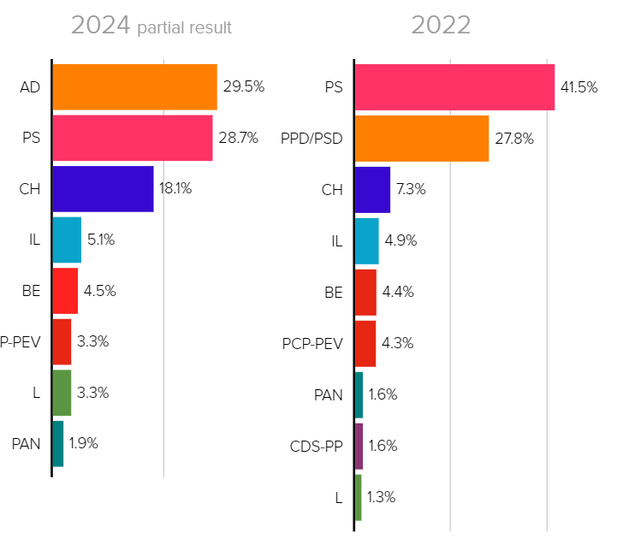
Portuguese Election 2024
Source: Politico, SGMai

Slide 11
Spanish Election 2023
Source: Politico

Slide 12
Polish Election 2023
Source: National Electoral Commission and Politico

Slide 13
Sardinian Elections 2024
Source: Sondaggi bidimedia

Slide 14
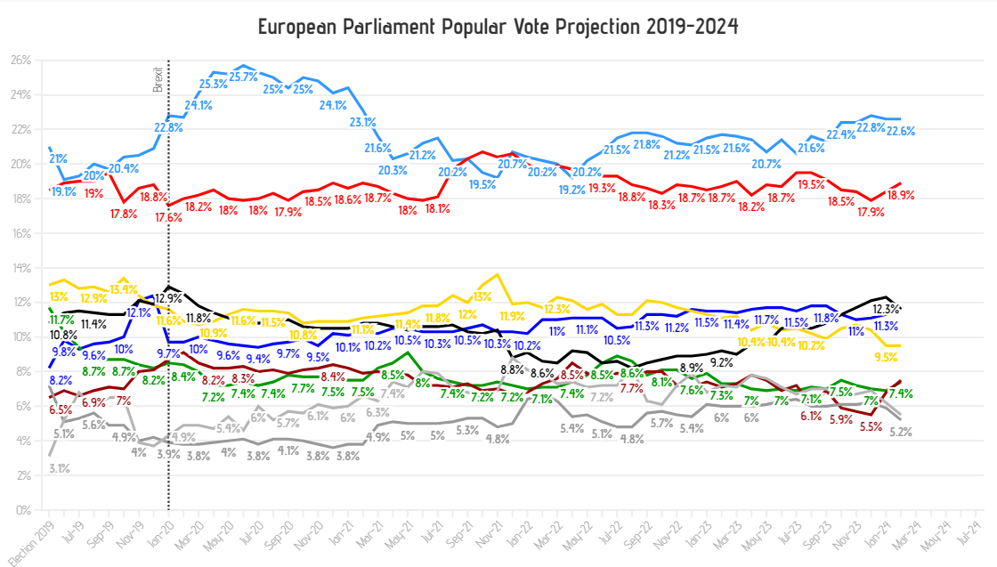
Elections Matter

Slide 15
Election interest is up
Source: DG Communication- European Parliament

Slide 16
2019 Election Turnout
Source: Statista

Slide 17
Polish Election Youth Vote
Source: TN24 Poland

Slide 18
Political Advertising

Slide 19
European Concerns
Source: Eurobarometer

Slide 20
Desires for New Parliament
Source: Eurobarometer

Slide 21
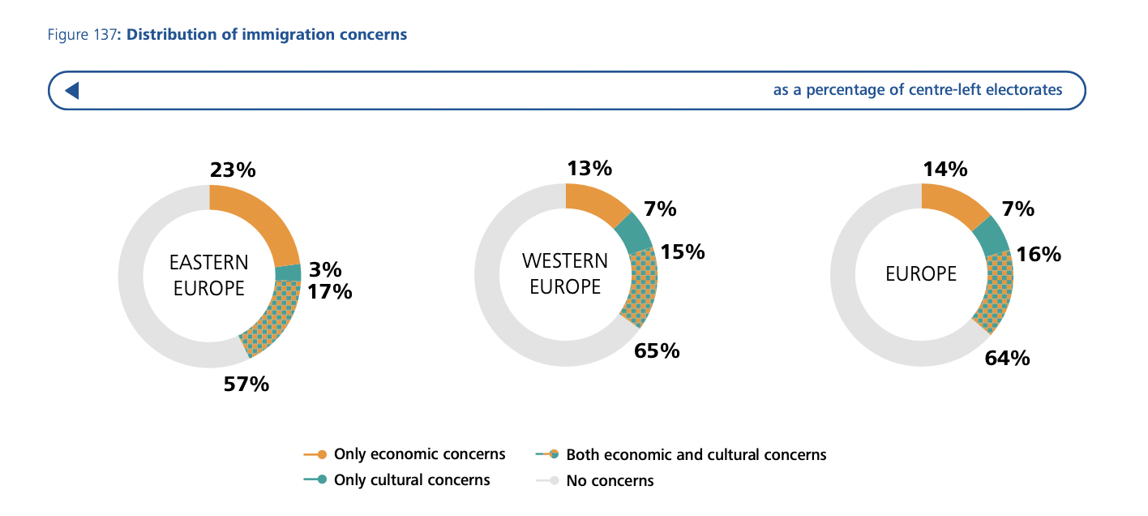
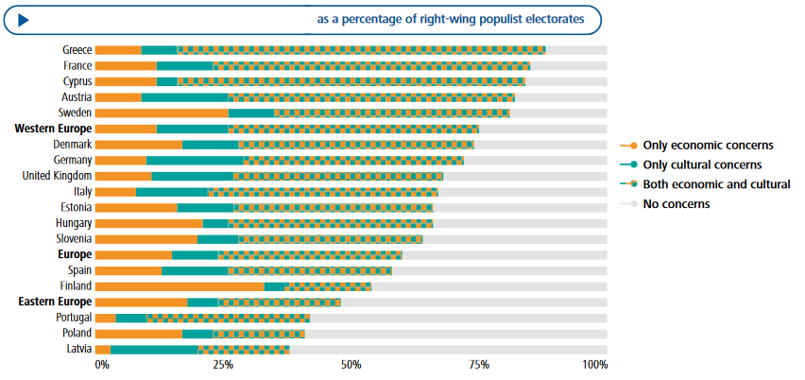
Cultural vs. Material
Source: Daphne Halikiopoulou, York University

Slide 22
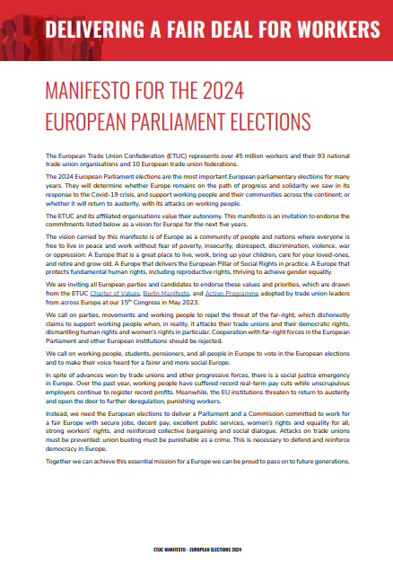
Election Manifesto
https://www.etuc.org/en/publication/get-etuc-manifesto-european-elections-2024-your-language

Slide 23
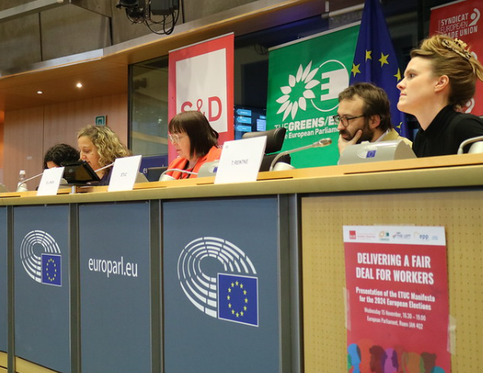
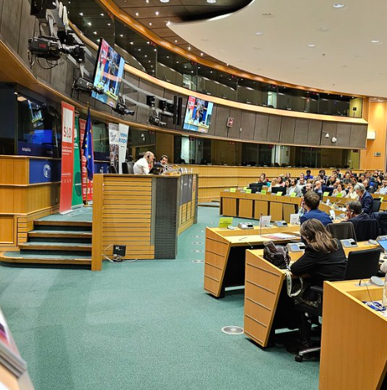
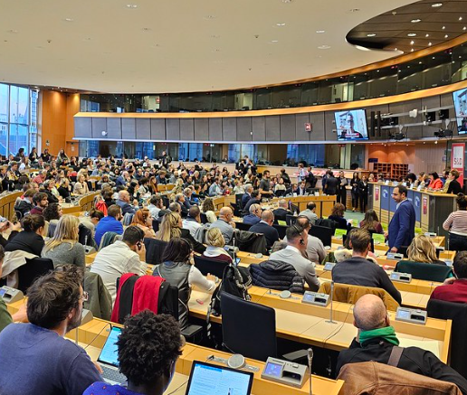
Manifesto Launch
European Parliament
15 November 2023

Slide 24
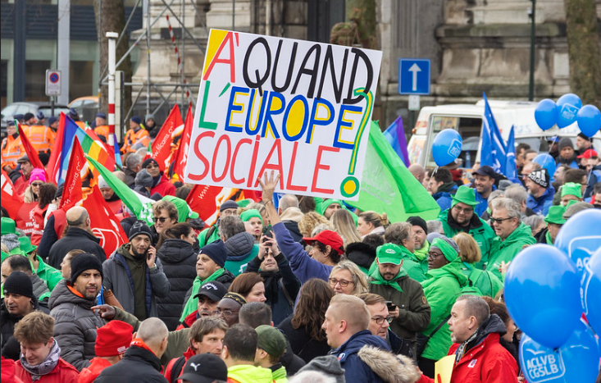
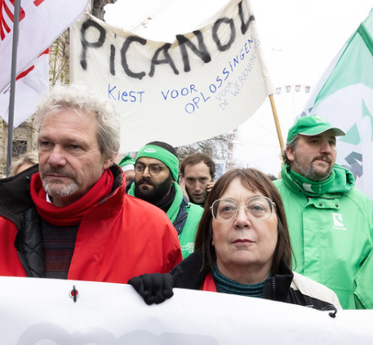
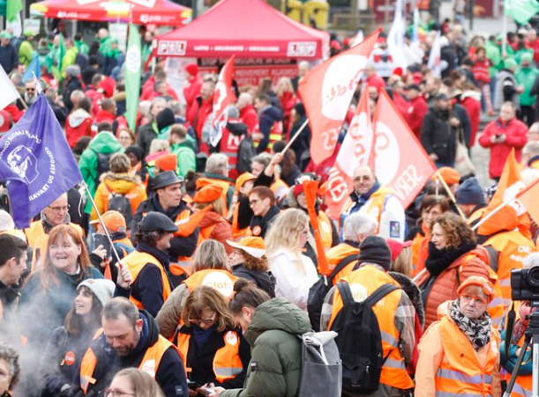
No to Austerity 2.0
Demonstration in Brussels
15 December 2023

Slide 25
A Fair Deal for Workers
Manifesto
Mobilising
Party Engagement
Highlight Votes
High Level Event
Executive Committees

Slide 26
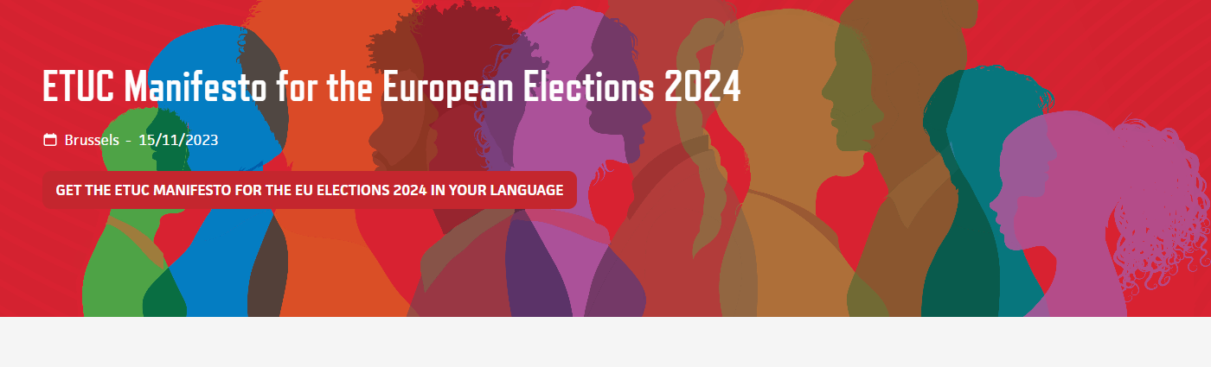
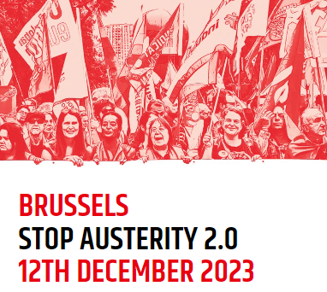
Engagement Offensive

Slide 27
ETUC Roadmap Actions
ETUI Training
Digital Engagement
Publish Votes
Trade Union Dates

Slide 28
Election Campaign
Counteract Narratives
Share Material
Youth Committee
Women’s Committee
FERPA
Anti Far Right Working Group

Slide 29
Affiliate engagement
Translate
Join Mobilisations
Organise Initiatives
Election Engagement
Major Elections Event
1st of May- Euro Elections

