Slide 1
The populist radical-right and the welfare state Juliana Chueri
Assistant Professor Vrije Universiteit Amsterdam EZA Brussels Conference 2024

Slide 2
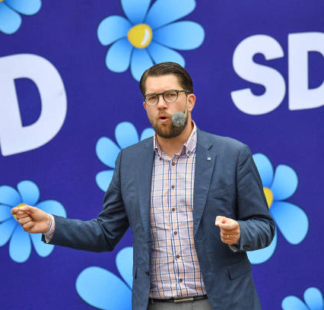
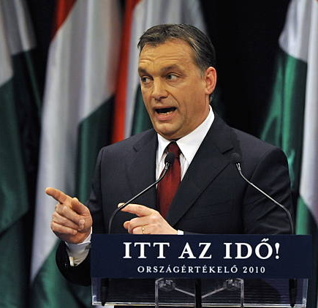
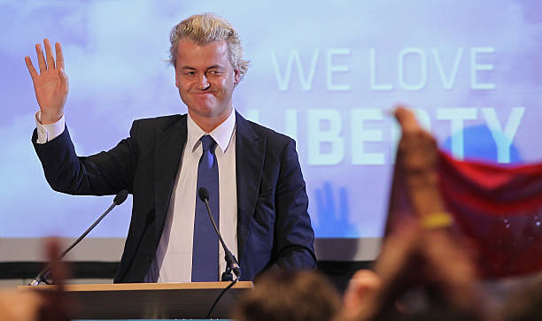
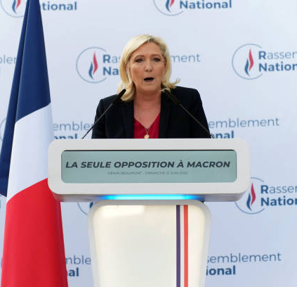

Slide 3
Radical right parties are reshaping the European welfare states and challenging traditional notions of European solidarity by dividing society into two groups: those deemed deserving of welfare benefits and those who are not.

Slide 4
Background of The Evolution of Welfare State Issues in Populist Radical Right Agenda

Slide 5
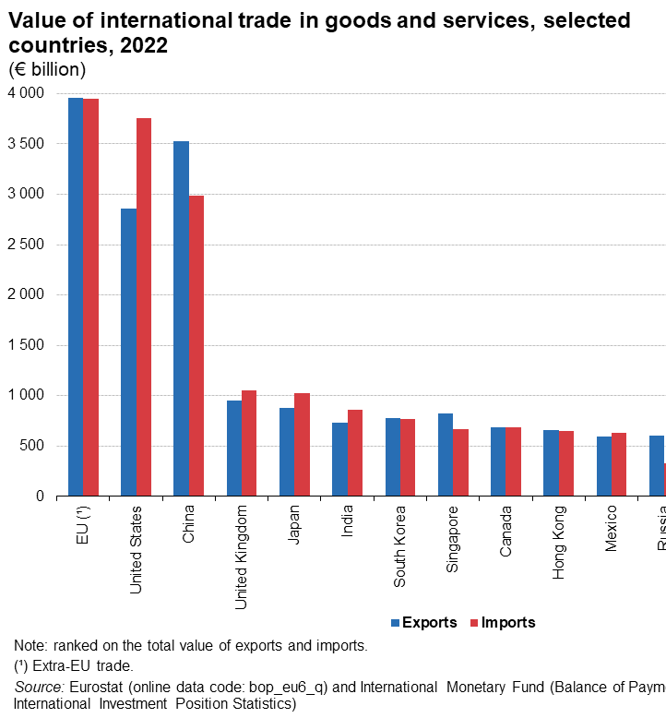
Europe has benefited from globalization
Globalization led to more jobs.
38 million jobs, direct or indirect, related to exports
Jobs connected to exports are better-paid.
Better living conditions due to the availability of cheaper goods.

Slide 6
But not everyone has profited to the same extent
High-skill workers benefited the most
Workers in manufacturing jobs were particularly harmed
Offshoring
Automation
Context also changed
Decrease in union density
Liberalization of labor protection
Welfare state cuts
Percentage of the workforce in manufacturing jobs (1970-2016)
Eurostat

Slide 7
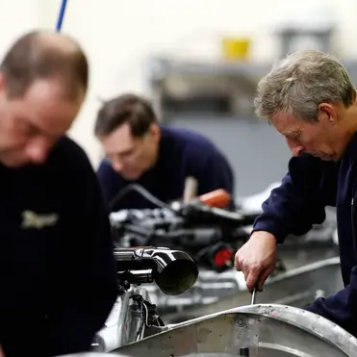
Deceived by globalization
Part of the population resent and fear those transformations.
Loss in relative status in society
Economic anxiety and fear of income insecurity
Radical-right welfare ideology speaks directly to those anxieties.

Slide 8
What is the populist radical-right welfare ideology?

Slide 9
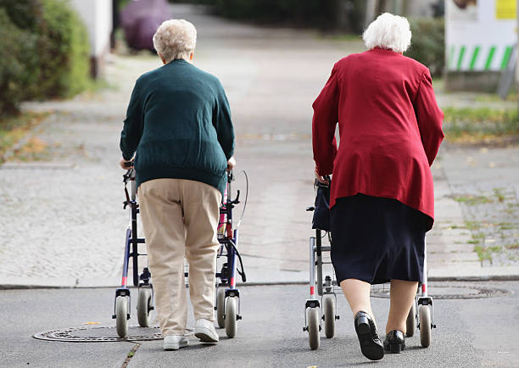
PRRPs have two distinctive welfare logics
For the ‘deserving’: Protectionist welfare state
• Generosity
• Income replacement schemes
For the ‘undeserving’: Residual welfare state
• Workfare interventions
• Conditionalities
• Welfare cuts

Slide 10
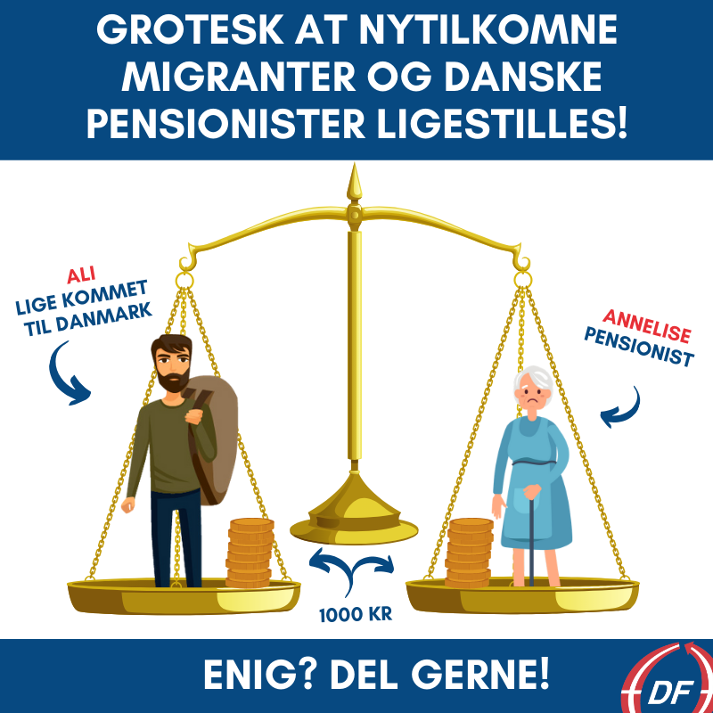
Who are the “deserving” and “underserving”?
Welfare chauvinism: the welfare state should be reserved for citizens.

Slide 11
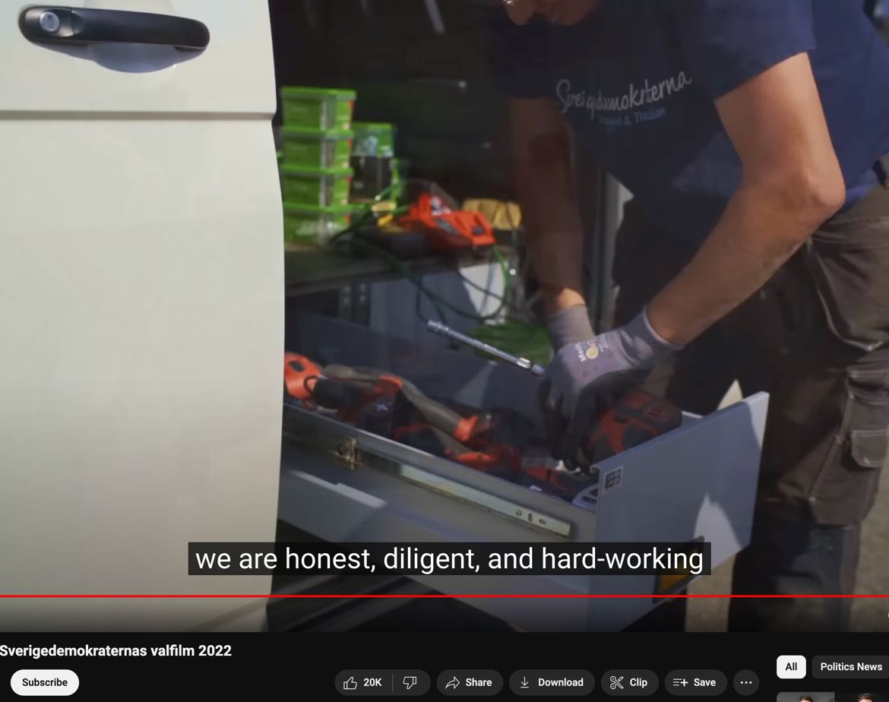
Who are the “deserving” and “underserving”?
The welfare state should be reserved for hard-working members and those who contribute to society.
“Work-shy” and “welfare abusers” are a threat.

Slide 12
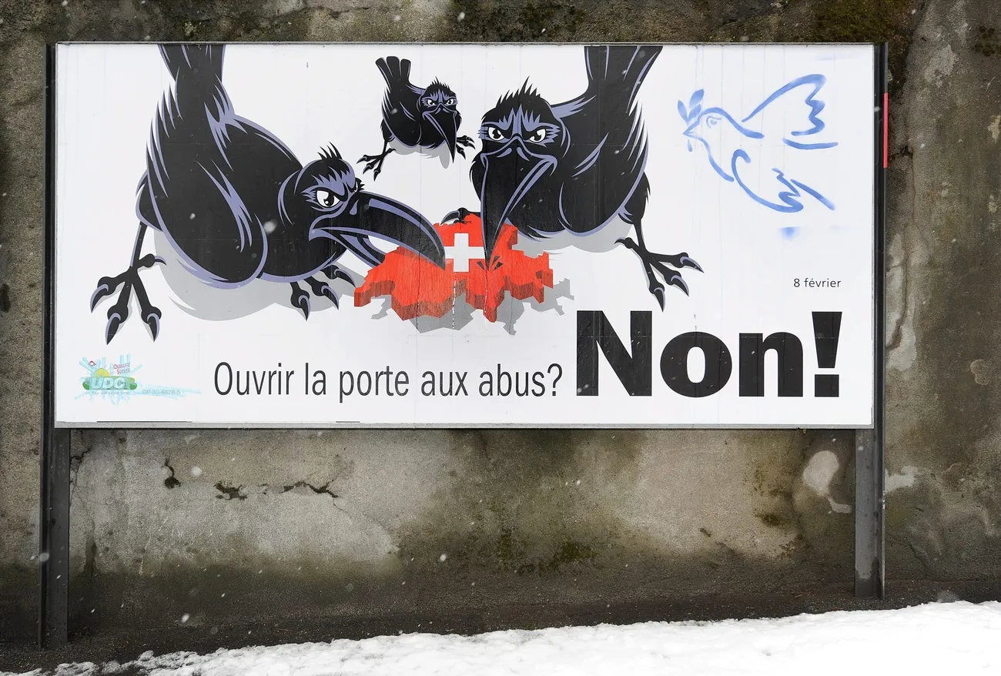
Appeal
The differentiation fosters competition among societal groups, rooted in the belief that the state must exclude the ‘undeserving’ to preserve welfare benefits for the ‘deserving’.

Slide 13
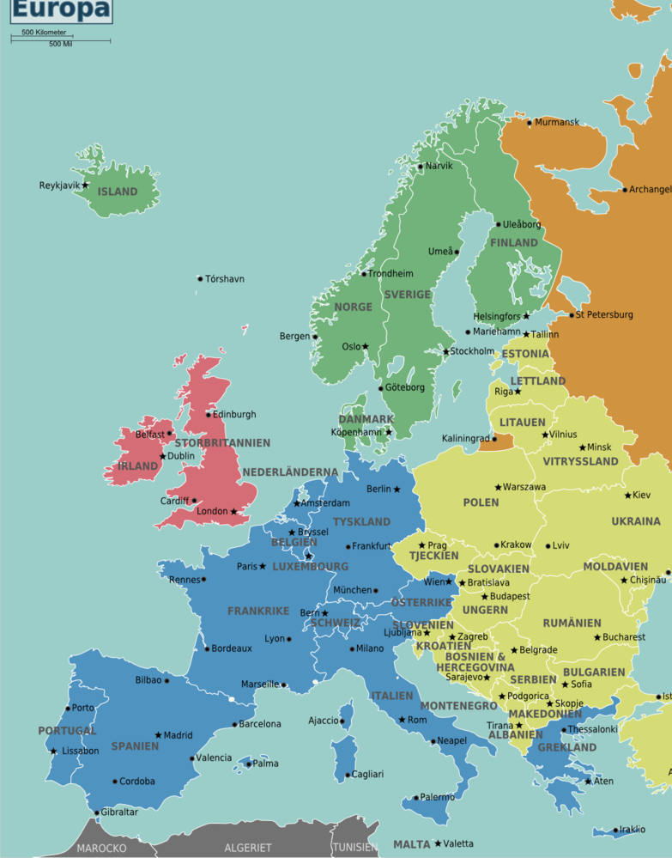
Differences across Europe
Welfare chauvinism and defense of generous benefits are more prevalent in developed welfare states.
Emphasis of family social policies and child benefits often in countries with more traditional gender roles.
Pensioners and families are always seen as the most deserving groups.

Slide 14
How have they transformed the welfare state?

Slide 15
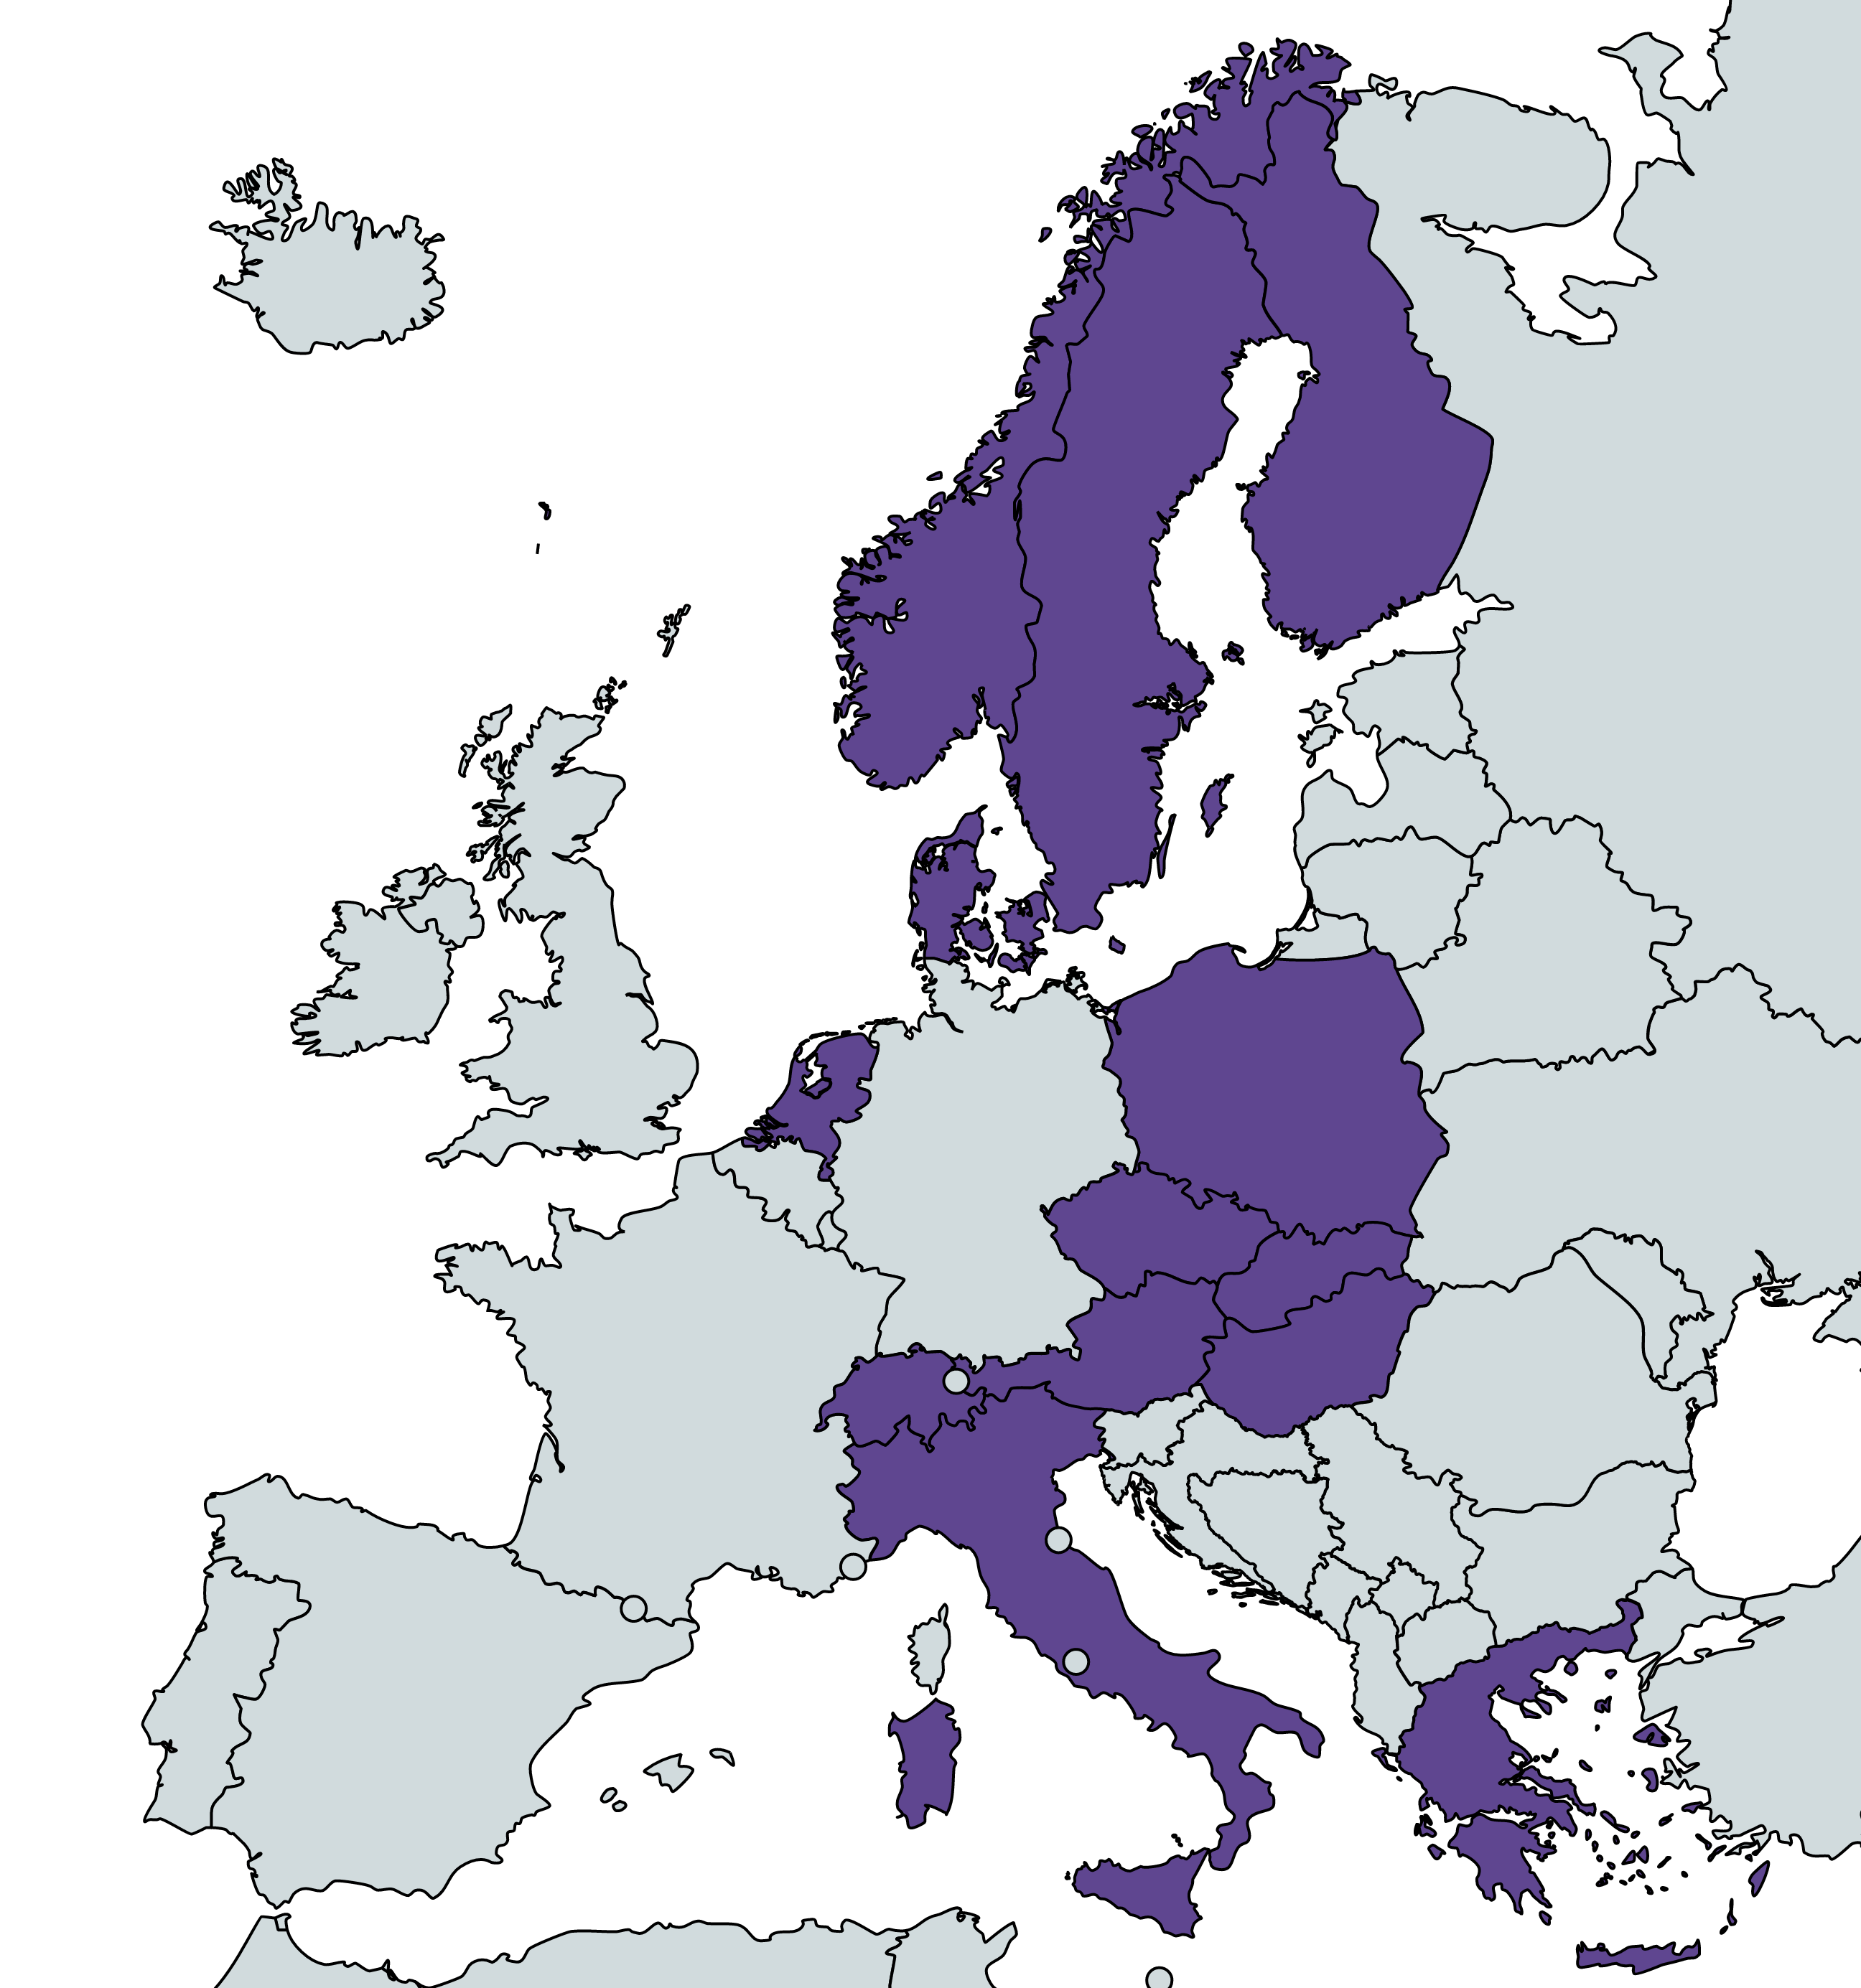
Social policy outcome of PRRPs government participation
1. More welfare cuts compared to mainstream governments.
2. “Underserving” bear most of the burden
Long-term unemployment benefits and social assistance
Immigrants’ social rights
Asylum seekers and EU migrants are the most targeted groups.
European countries where populist radical right parties have participated in the government (1990-2023)

Slide 16
Social policy outcome of PRRPs government participation
3. Protect the welfare for the “deserving”
Less restrictive on pensions than mainstream governments.
Longer transition periods for pension reforms and protect early retirement.
Negotiate expansions on family benefits in conservative welfare states.
European countries where populist radical right parties have participated in the government (1990-2023)

Slide 17
They also matter when they are not in government
Contagion effect on both mainstream right and left-wing parties.
Restrictions on immigrants’ social rights by mainstream governments
Similar deservingness narrative.

Slide 18
Implications of radical-right vision on welfare issues

Slide 19
Threat to European solidarity
Radical right parties are becoming the authority on welfare state policies.
Equality is no longer a goal.
Creation of an “undeserving” group makes poverty and social exclusion justifiable.
«Defense» of the welfare state as a justification for the restriction of minority rights and attacks on liberal democratic institutions.

Slide 20
Thank you!
j.chueri@vu.nl

